Slide 1
cts
Seamless AV
MONTHLY BUSINESS REVIEW
September 2026
Results, departments, spending, customers, cash and utilisation
Finance Operations Manager
Notes:
Monthly Business Review for September 2026. Every figure in this pack is drawn from the Financial Controller Pack, which reconciles to the Xero general ledger to the cent for each department and for the company.
Revenue for the month was $561,945 against a budget of $413,665, exceeding budget by $148,280. EBITDA was a loss of $32,437 against a budgeted loss of $107,100.
The month is explained by gross margin and the fixed overhead base rather than by sales performance.

Slide 2

AGENDA
What we will cover
01
Financial performance
P&L summary, the three months to date, and every department against budget
02
What we spend
Where the money goes: cost distribution, operating expense, labour and employment
03
Customers and cash
Top ten customers, receivables and days sales outstanding
04
People and utilisation
Chargeable hours by department and the profit they produce
05
Budget and outlook
Revenue by month against budget, and what we do about it
Notes:
The review is set out in five sections.
Financial performance opens, as it carries the result for the month. What we spend follows, because the cost base explains most of the outcome. Customers and cash, people and utilisation, and the budget outlook complete the review.

Slide 3
INTRODUCTION
Where the business stands, Sep 26
SUPPORT
EVENTS
VIDEO
INTEGRATION
CONSULTING
TOTAL
$243k
$73k
$7k
$235k
$4k
$562k
revenue
revenue
revenue
revenue
revenue
revenue
42% gross margin
78% gross margin
80% gross margin
10% gross margin
2% gross margin
33% gross margin
+$29k after overhead
$(54)k after overhead
$(7)k after overhead
+$10k after overhead
$(20)k after overhead
$(41)k after overhead
Behind budget by $5k
Ahead of budget by $7k
Behind budget by $10k
Ahead of budget by $176k
Behind budget by $20k
Ahead of budget by $148k
Revenue
Gross margin
Overheads
EBITDA
Break even needs
$562k
33.4%
$230k
$(32)k
$549k
budget $414k
last Sep 45.5%
budget $232k
budget $(107)k
running at $541k
The month in summary. September revenue exceeded budget by $148k, while EBITDA remained a loss of $32k. Support is the only department covering its allocated overheads. The revenue variance arose almost entirely in Integration at a 10.1% gross margin, contributing turnover with very little profit. At the year-to-date gross margin of 38.9%, monthly revenue of approximately $549k is required to cover overheads, against a current average of $541k.
Notes:
Where the business stands at September 2026, by department and for the company.
Support generated $243k of revenue at a 41.7% gross margin and $29k after allocated overheads. Events generated $73k at 77.6% and a loss of $54k. Video generated $7k at 79.6% and a loss of $7k. Integration generated $235k at 10.1% and $10k. Consulting generated $4k at 2.1% and a loss of $20k.
For the company, revenue of $562k against a $414k budget, a gross margin of 33.4% against 45.5% in September last year, overheads of $230k against a $232k budget, and EBITDA of a $32k loss against a budgeted $107k loss.
In summary, revenue exceeded budget while the company remained in loss. Support is the only department covering its allocated overheads. The revenue variance arose almost entirely in Integration at a 10.1% gross margin, which contributed turnover with very little profit.

Slide 4
SECTION
01
Financial performance
The P&L for September 2026 and the year to date
Notes:
Financial performance for September 2026 and the quarter to date.

Slide 5
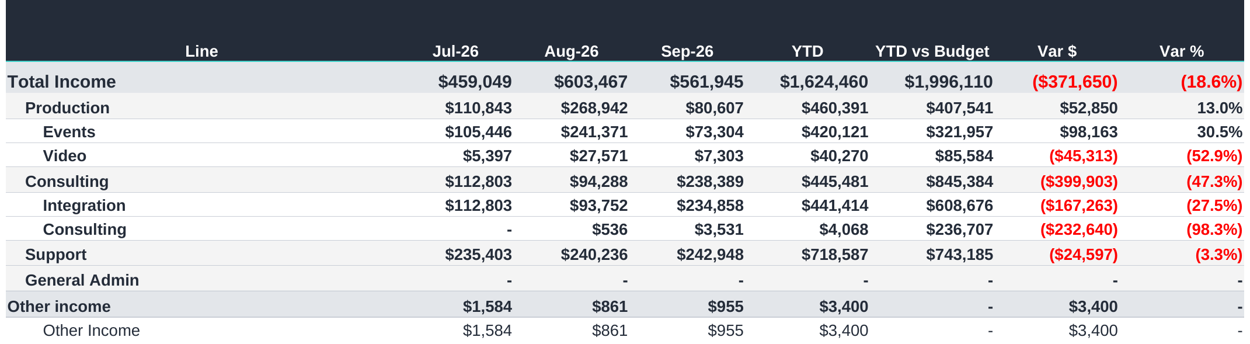
FINANCIAL PERFORMANCE
P&L summary, income
COMMENTARY
At the year-to-date gross margin of 38.9%, monthly revenue of approximately $549k is needed to cover overheads. The current average is $541k.
September revenue was $148k above budget, but EBITDA remained a loss of $32k.
Gross margin was 33.4%, compared with the 30.1% budget and 45.5% in September last year.
Overheads were $230k, slightly below the $232k budget.
Year-to-date EBITDA is $6k against a $223k budget. Our forecast should place greater focus on gross margin and profitability.
Notes:
The P&L summary is taken from the Summary tab of the Financial Controller Pack and is shown as it appears on screen with the outline closed.
Revenue of $561,945 against a budget of $413,665, exceeding budget by $148,280 and 58% above the $356,323 recorded in September last year.
Gross profit of $187,814 at 33.4%, against a budgeted 30.1% and 45.5% in September last year. The budgeted margin for September was unusually low, so exceeding it reflects the budget rather than an improvement in delivery.
Overheads of $230,233 against a budget of $231,573.
EBITDA a loss of $32,437 against a budgeted loss of $107,100, and a net loss of $41,464 after depreciation and amortisation of $9,982.
Year to date, revenue of $1,624,460 against $1,996,110, behind budget by $371,650, with EBITDA of $5,774 against $222,700.
The figure worth carrying from this slide is break even. At the year to date gross margin of 38.9%, the business requires $549,372 of revenue each month to cover overheads and is averaging $541,487. That gap is structural, and additional sales at the current margin would not close it.

Slide 6
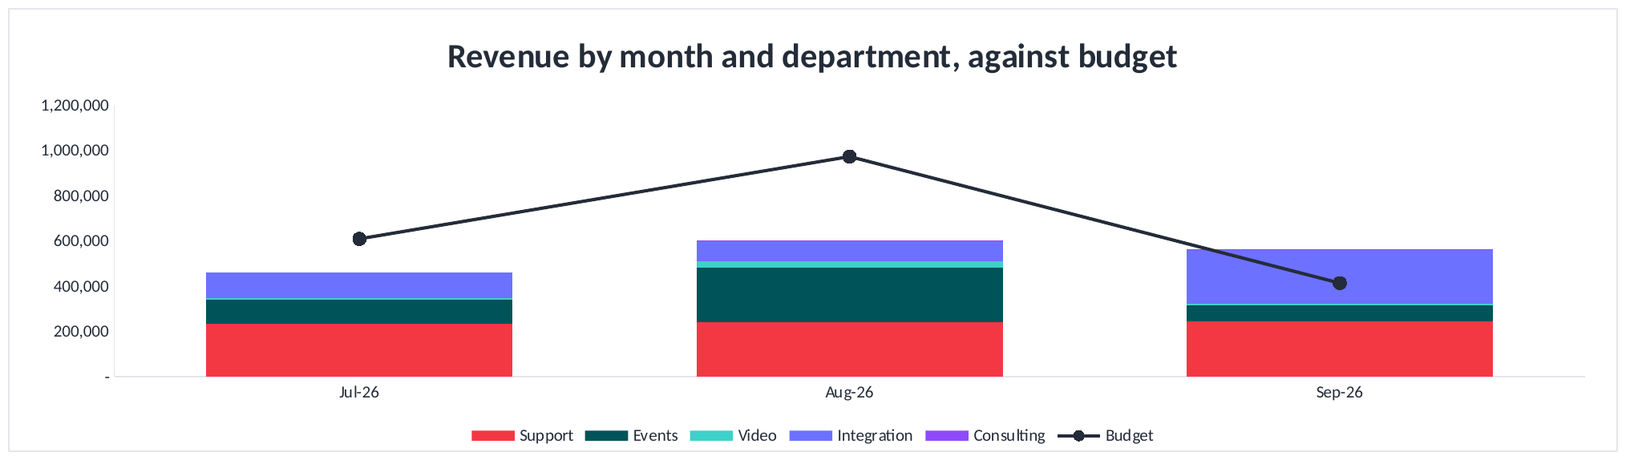
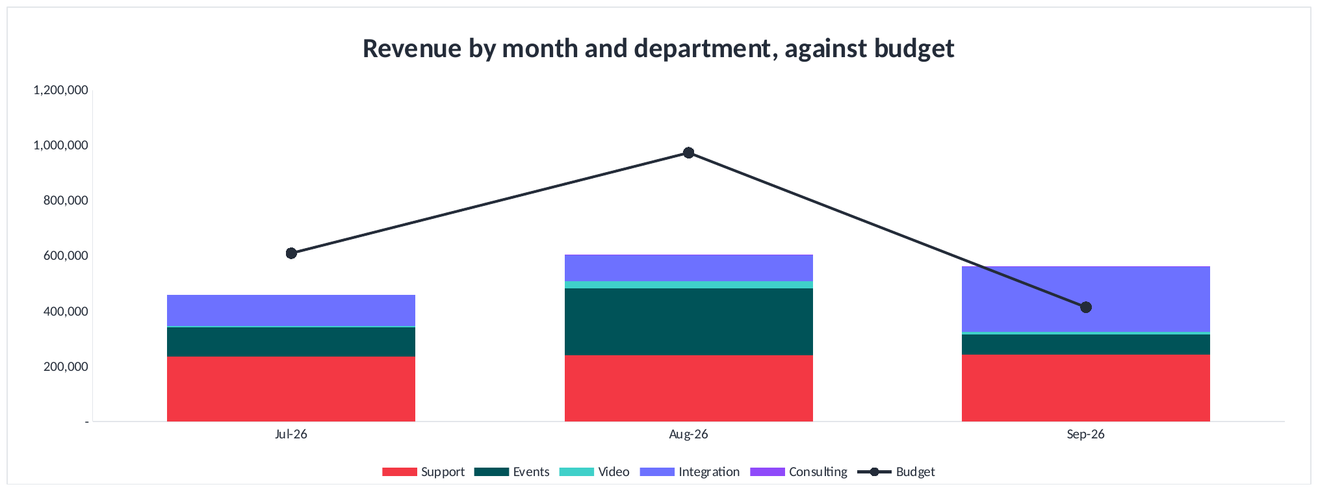
FINANCIAL PERFORMANCE
Revenue by month and department
COMMENTARY
Revenue was $459k in July, $603k in August and $562k in September, $1,624k for the quarter.
Budget for the same three months was $1,996k, so the quarter is $372k short.
July and August were both well under budget. September came in $148k above it.
Support is the steady base at $235k, $240k and $243k.
September's movement is Integration at $235k against $94k in August, on project completion.
Notes:
Revenue by month and department for the closed quarter, with the budget for the same months, taken from the Cost Analysis tab.
Actual revenue was $459,049 in July, $603,467 in August and $561,945 in September, $1,624,460 for the quarter.
Budget for those months was $609,277, $973,168 and $413,665, being $1,996,110 for the quarter. The quarter is therefore $371,650 short of budget.
The monthly picture is not what the quarter total suggests. July came in $150,228 under budget and August $369,701 under, while September came in $148,280 above. Two thirds of the quarter's shortfall sits in August alone, where the budget asked for $973,168, more than the business has ever billed in a month.
By department for September: Support $242,948, Events $73,304, Video $7,303, Integration $234,858 and Consulting $3,531.
Three things the mix shows that a total does not.
Support is the base of the business and it barely moves: $235,403, $240,236 and $242,948 across the three months. That is recurring contract income behaving as recurring income should.
Integration is the volatility. It billed $112,803 in July, $93,752 in August and $234,858 in September, and the September figure is a single installation completing. It is better read as timing than as growth, particularly as the margin retained on that work is 10.1%.
Events moved from $241,371 in August to $73,304 in September, the largest single movement in the quarter, and the reason the company total fell while Integration rose.
The chart lengthens by one column each month as the pack closes a month, so it will show the full year by June without being rebuilt.

Slide 7
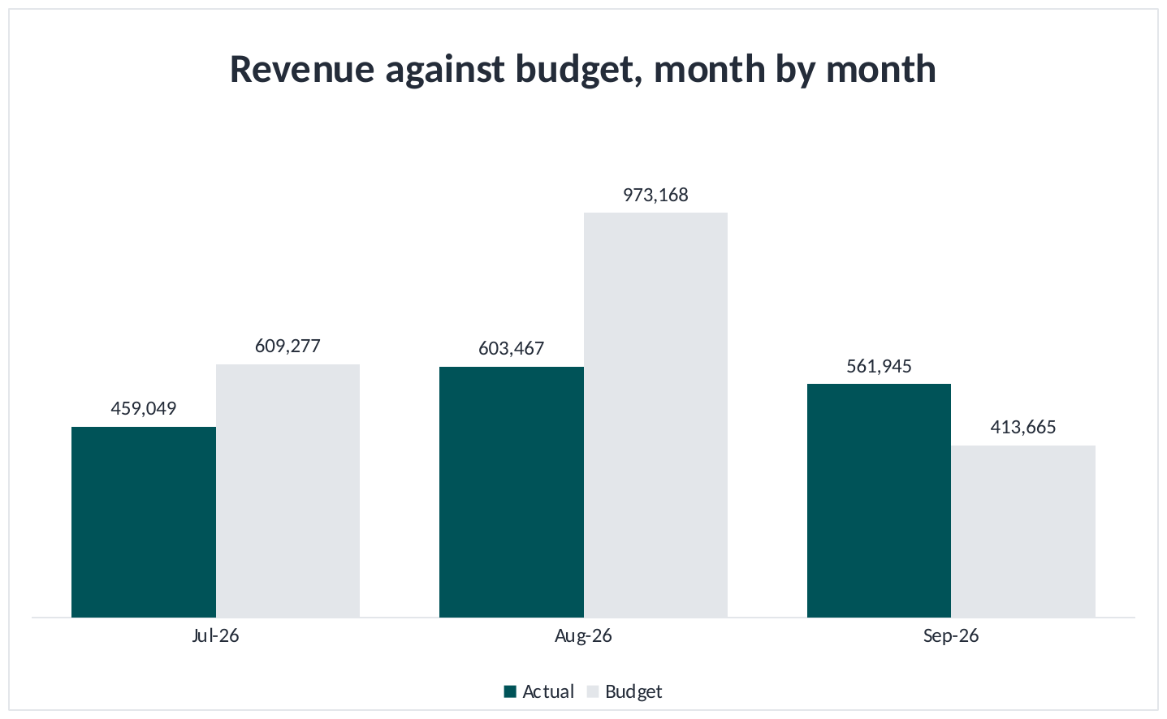
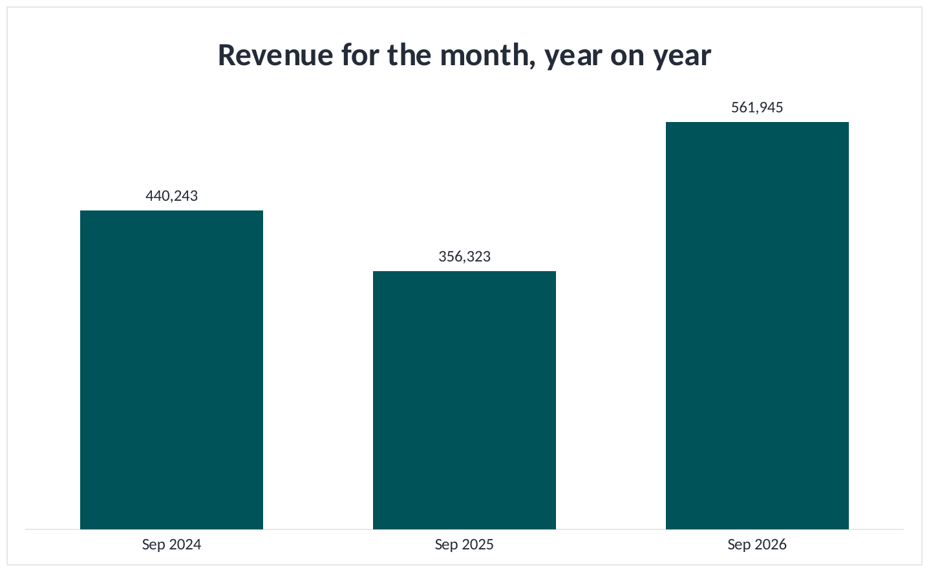
FINANCIAL PERFORMANCE
Revenue, against budget and year on year
COMMENTARY
September billed $562k against a $414k budget, $148k ahead of it, and against $356k last September.
Year to date is $1,624k against $1,996k, short by $372k or 19%.
Almost all of that shortfall is August, which billed $603k against a $973k budget.
Against FY25 rather than the weak FY26, September is 28% ahead. That is the steadier read on growth.
Notes:
Revenue against budget month by month, and revenue for the month across three years. Both taken from the Cost Analysis tab.
Against budget, month by month. July billed $459,049 against $609,277, short by $150,228. August billed $603,467 against $973,168, short by $369,702. September billed $561,945 against $413,665, ahead by $148,280. Year to date $1,624,460 against $1,996,110, short by $371,650 or 18.6%.
August is where the year to date shortfall sits. It was budgeted as the second largest month of the FY27 budget and came in $369,702 under. September went the other way and recovered $148,280 of it.
Against the same month in earlier years. September 2026 $561,945, September 2025 $356,323, September 2024 $440,243. September 2026 is $205,621 or 57.7% ahead of last year and $121,701 or 27.6% ahead of the year before. September 2025 was itself 19.1% below September 2024.
The 57.7% figure flatters the result because FY26 was the weakest of the three years. Against FY25 the same month is 27.6% ahead, which is about 13% a year over two years, and that is the number to carry into the reforecast.
The two charts sit together because they answer the same question from two sides. The month is ahead of where it was a year ago and ahead of its own budget. The year to date is behind budget, and that is an August problem rather than a September one.
Xero holds the last three financial years, so September 2024 is the earliest September available for the comparison.

Slide 8
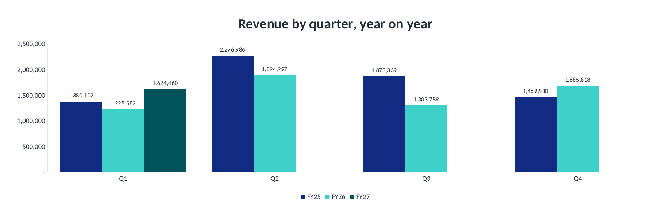
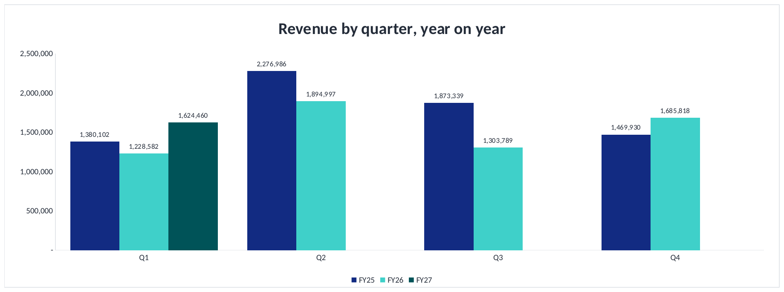
FINANCIAL PERFORMANCE
Revenue by quarter, year on year
COMMENTARY
The first quarter was $1,624k, the strongest of the three years.
It is also the smallest quarter of the year. The second quarter carries about 32% of revenue.
FY26 lost its year in the third quarter: $1,304k against $1,873k, down 30%.
The second quarter is next and it decides the year. FY25 billed $2,277k in it, FY26 $1,895k.
Notes:
Revenue by quarter across three years, taken from the Xero History tab.
First quarter: FY25 $1,380,102, FY26 $1,228,582, FY27 $1,624,460.
Second quarter: FY25 $2,276,986, FY26 $1,894,997.
Third quarter: FY25 $1,873,339, FY26 $1,303,789.
Fourth quarter: FY25 $1,469,930, FY26 $1,685,818.
Three things come out of this that the single quarter comparison could not show.
The first is that the quarter just closed is the smallest quarter of the year in both completed years, and FY27 has made it the largest first quarter of the three. That is a genuinely good result and it is worth saying so.
The second is where FY26 actually lost its year. It was the third quarter, January to March, which fell $569,550 or 30.4% below the same quarter of FY25. The first quarter of FY26 was 11.0% below and the second 16.8% below, but the third is where the damage was done. The fourth quarter was the one quarter FY26 beat FY25, by $215,888 or 14.7%.
The third is what is immediately ahead. The second quarter has carried 32.5% of FY25 and 31.0% of FY26, which makes it the quarter the year is won or lost in. October alone was the largest month of both completed years. The FY27 budget has October at $950,416, and the first quarter has run 18.6% behind budget on revenue. A second quarter that behaves like FY26's rather than FY25's would widen the full year gap by around $380,000 on its own.
FY27 shows one quarter because one quarter has closed. The chart fills in as each quarter closes.

Slide 9
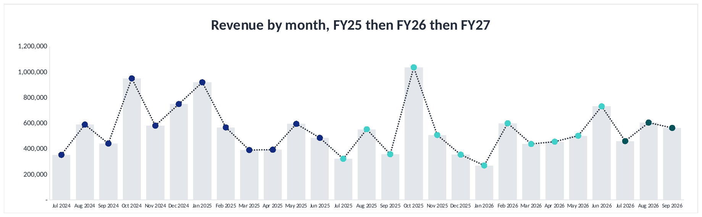
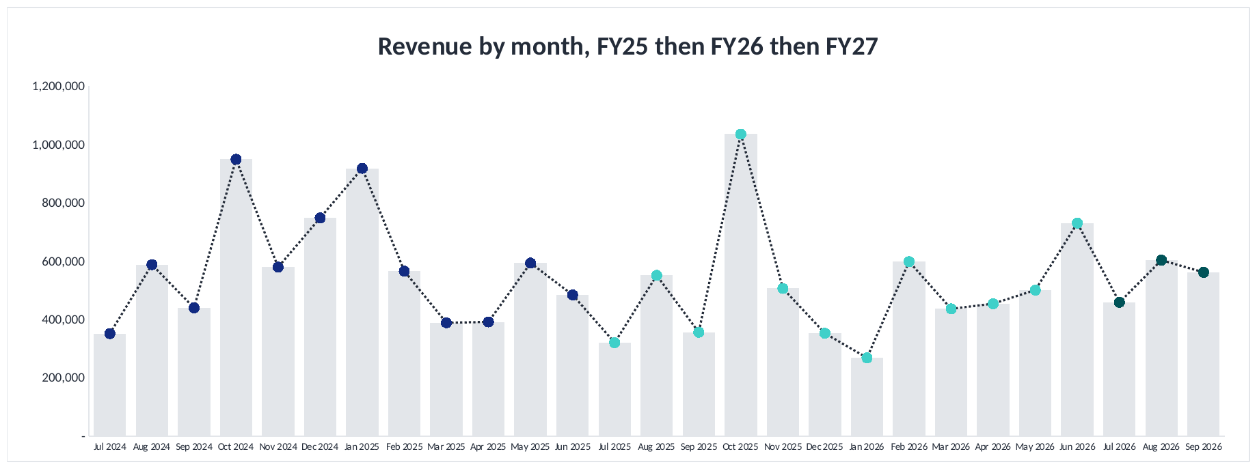
FINANCIAL PERFORMANCE
Three years of revenue by month
COMMENTARY
Thirty six months of revenue, from July 2024 through to September 2026.
FY26 was the softer year at $6,113k against $7,000k, and it was down in both halves.
The largest single swing is January: $918k in FY25 against $269k in FY26.
October carries the year. It was $949k in FY25 and $1,036k in FY26, and FY27 has it budgeted at $950k.
Notes:
Thirty six months of revenue, taken from the new Xero History tab.
FY25 totalled $7,000,357 and FY26 $6,113,186, a fall of $887,171 or 12.7%. FY27 stands at $1,624,460 after three months.
The fall in FY26 was not confined to one half. The first half was $533,509 or 14.6% below FY25 and the second half $353,662 or 10.6% below.
Two features of the shape are worth the board's attention.
The first is October. It was the largest month of FY25 at $948,991 and the largest month of FY26 at $1,035,562, and the FY27 budget repeats that pattern with $950,416. October is a quarter of the way to a seven figure month on its own, and if it behaves like the rest of FY27 rather than like its own history, the full year gap against budget widens materially. There is no second October in the year to recover it.
The second is January. FY25 billed $918,289 in January and FY26 billed $268,631, a swing of $649,658 in a single month. January is the month most exposed to how much work carries over the Christmas shutdown, and it is the month least able to be recovered once it is gone.
On the source and how it is maintained. FY25 was pulled from Xero on 22 October 2026 as total income by month on the accrual basis, and is held on the tab as figures, because the pack has no FY25 tab to reference. FY26 and FY27 are references to the Actual FY26 and P&L FY27 tabs, so they follow the pack rather than duplicating it, and FY27 shows closed months only. Four months were checked against Xero directly and agree to the cent, apart from one cent of rounding on September 2025.
Xero serves the last three financial years. FY23 and FY24 cannot be pulled, which is why the history begins in July 2024.

Slide 10
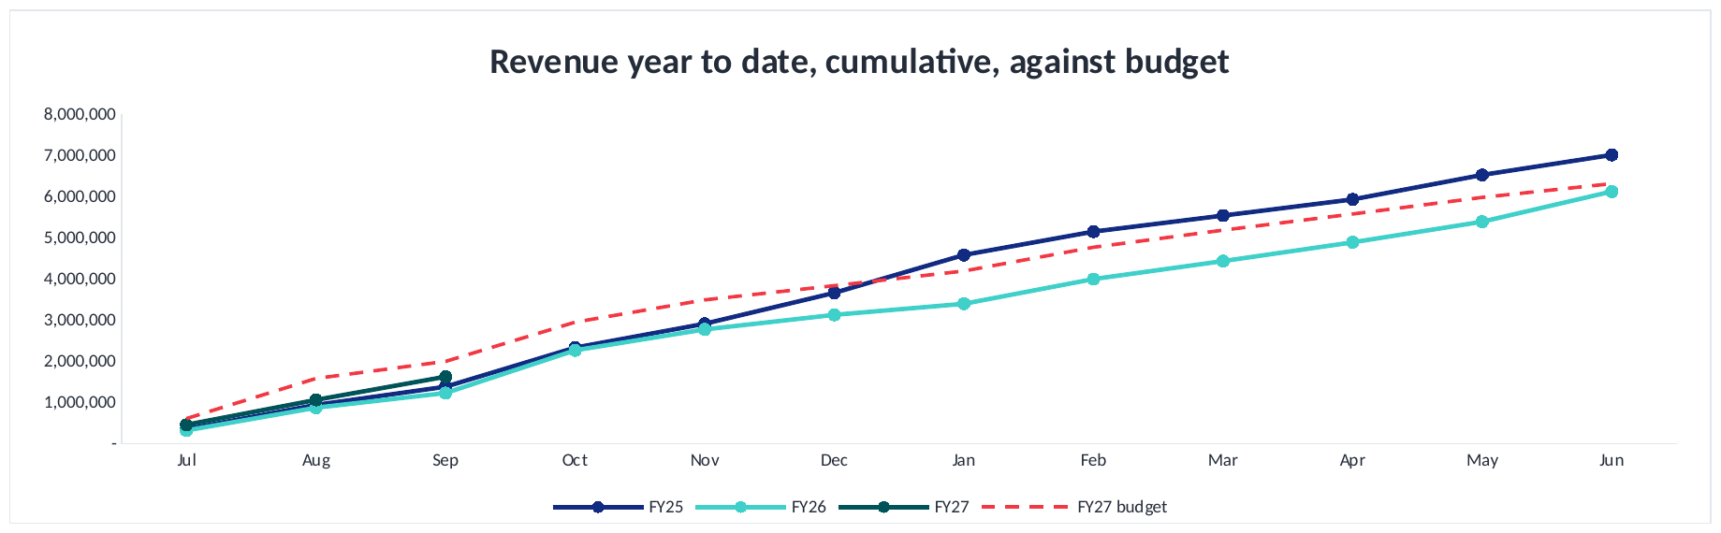
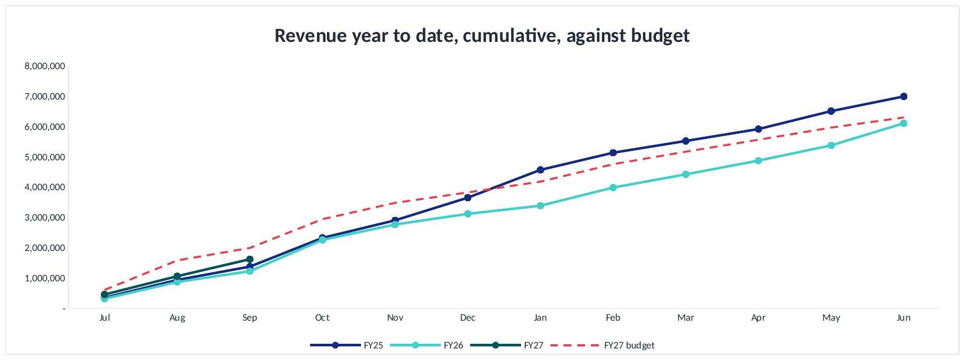
FINANCIAL PERFORMANCE
Revenue year to date, against budget
COMMENTARY
Year to date revenue is $1,624k, ahead of both completed years at this point in the year.
It is $372k or 19% behind budget. Almost all of that opened in August, and September closed $148k of it back.
FY26 lost its year in December and January, $1,045k behind FY25 across those two months.
The full year budget of $6,305k is itself 10% below what FY25 actually billed.
Notes:
Revenue year to date on a cumulative basis, three years against the FY27 budget, taken from the Xero History tab.
At September: FY27 $1,624,460, FY26 $1,228,582, FY25 $1,380,102, and the FY27 budget $1,996,110.
The year is ahead of both completed years at this point. It is $371,650 or 18.6% behind the budget set for it.
Where that gap came from, month by month. July was $150,228 behind budget. August was $369,702 behind, which is where almost all of it opened. September was $148,280 ahead of budget, which closed part of it back. August was budgeted at $973,168, the second largest month of the FY27 budget, and billed $603,467.
What the two completed lines show is where a year gets lost. FY25 and FY26 track each other almost exactly from July to November. They separate in December and January. December was $395,542 behind and January $649,658 behind, $1,045,200 across the two months, against a full year gap of $887,171. Every other month of FY26 combined was ahead of FY25.
That matters now because FY27 is about to enter the same two months, and the budget has December at $344,970 and January at $353,969, both well below what FY25 billed in them.
The last point is the budget itself. The full year FY27 budget is $6,304,601. FY25 actually billed $7,000,357. The plan for this year is $695,756 or 9.9% below what the business delivered two years ago, and $191,415 or 3.1% above FY26. Being 18.6% behind that budget is the gap against a plan that was already set below the FY25 result.
The FY27 line stops at September because the months beyond it hold budget rather than actuals. The budget line runs the full year because a budget is set for the whole year.

Slide 11
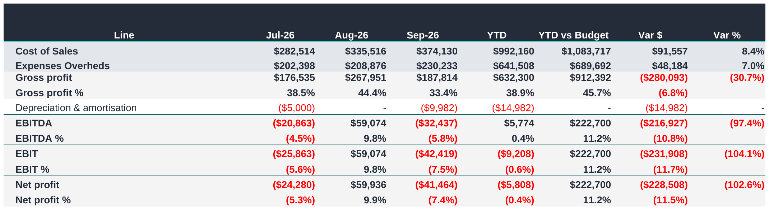
FINANCIAL PERFORMANCE
P&L summary, cost and profit
COMMENTARY
Year-to-date EBITDA is $6k against a budget of $223k, a shortfall of approximately $217k.
The first quarter accounted for 56% of the full-year EBITDA budget, making the current shortfall significant.
To achieve the $397k annual target, the remaining nine months would need to deliver approximately $391k, compared with the original $175k budget.
That requirement is around 1.7 times the EBITDA achieved in the whole of last financial year, making the annual target highly unlikely without a significant change in performance.
Revenue reached 81% of the year-to-date budget, while gross profit reached only 69%. Improving gross margin is a priority.
Notes:
EBITDA against budget, which is the principal risk in this pack.
The quarter produced $5,774 of EBITDA against a budget of $222,700, a shortfall of $216,927 or 97.4%.
The shortfall matters more than the figure alone suggests. The FY27 budget provides for $397,251 of EBITDA for the year and placed $222,700 of that, 56%, in the first quarter. The year was planned to be earned early, and it was not, so the remaining nine months would have to carry the full amount.
To reach $397,251, the nine months from October would need to produce $391,477, or $43,497 a month. The budget asked those nine months for $174,551, or $19,395 a month. That is 2.2 times the monthly profit the plan assumed, in the months the plan treated as the quieter ones.
For context, the whole of FY26 delivered $235,273 of EBITDA. The next nine months would need $391,477, which is 1.7 times a full year of last year's result. In my view the full year EBITDA budget is no longer recoverable, and I would suggest the board is advised of that now rather than at the half year.
The cause is margin rather than sales. Revenue for the quarter reached 81.4% of budget, which is a reasonable result in itself. Gross profit reached 69.3% of budget. The gap between those two percentages is the issue: the business sold reasonably well and retained very little of it. September illustrates the point, with revenue exceeding budget by $148,280 while the month still recorded an EBITDA loss of $32,437.
The cost base cannot absorb that. Overheads ran at $641,508 for the quarter, $213,836 a month, and came in $48,184 under budget. Spending is not the cause and there is little further to remove that would be material. Wages and premises make up most of it and both are committed for the year, so a reduction in retained margin passes straight to the result.
On break even, at the 38.9% gross margin delivered, the business requires $549,372 of revenue a month to cover overheads and is running at $541,487. The business is trading at break even rather than at a profit, in the quarter the budget expected to be the strongest.
Two factors make the next two quarters harder. December is budgeted at a loss because the business closes for two weeks, so the second quarter cannot recover the gap. And with EBITDA at break even there is no earnings buffer, while $303,605 of cash sits in receivables above the 30 day target.
There is a genuine positive. The first quarter of last year was a loss of $85,404, so this quarter is $91,178 better. The business is improving year on year. It is the budget that was set above what the business can deliver, and that distinction is worth drawing clearly.
My recommendations are to reforecast now on margin rather than revenue, to rebuild Consulting around the capacity that exists, to reset the gross margin assumption to the rate delivered over two years, to hold December as budgeted, and to provide the board with a revised full year EBITDA they can rely on.

Slide 12
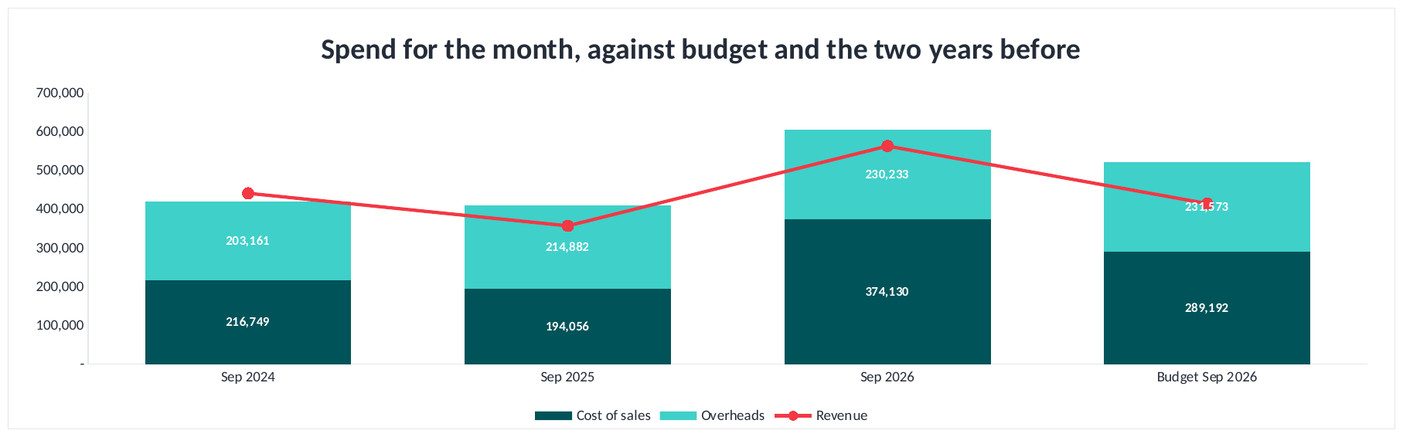
FINANCIAL PERFORMANCE
Spend for the month, against budget
COMMENTARY
September spend was $604k against a budget of $521k, $84k over.
All of the overspend is cost of sales: $374k against $289k budgeted.
Overheads came in at $230k against $232k budgeted, which is on plan.
Spend is up 48% on last September and 44% on the September before.
Notes:
Spend for September across three years and against budget, taken from the Xero History tab.
Spend here is cost of sales plus overheads. September 2026 $604,363. Budget $520,765. September 2025 $408,939. September 2024 $419,910.
September was $83,599 or 16.1% over budget on spend.
Where that sits matters more than the total. Cost of sales was $374,130 against $289,192 budgeted, which is $84,938 over. Overheads were $230,233 against $231,573 budgeted, which is $1,340 under. So the entire overspend is cost of sales and the overheads landed on plan.
That is the better of the two outcomes. Cost of sales moves with revenue, and September billed $561,945 against a budget of $413,665, so some of the extra cost bought extra revenue. Overheads do not move with revenue, and those held.
Against the two earlier years, spend is up $195,425 or 47.8% on September 2025 and $184,453 or 43.9% on September 2024. Revenue over the same two years is up 57.7% and 27.6%, so spend has grown faster than revenue against FY25 and slower than revenue against FY26.
The red line is revenue. It sat above the spend bar in September 2024 and below it in both years since, which is the same thing as saying those two Septembers lost money.
FY25 comes from Xero, pulled on 22 October 2026. FY26 is the Actual FY26 tab and FY27 the P&L FY27 tab. The month follows the reporting month on Setup, so in October this becomes October.

Slide 13
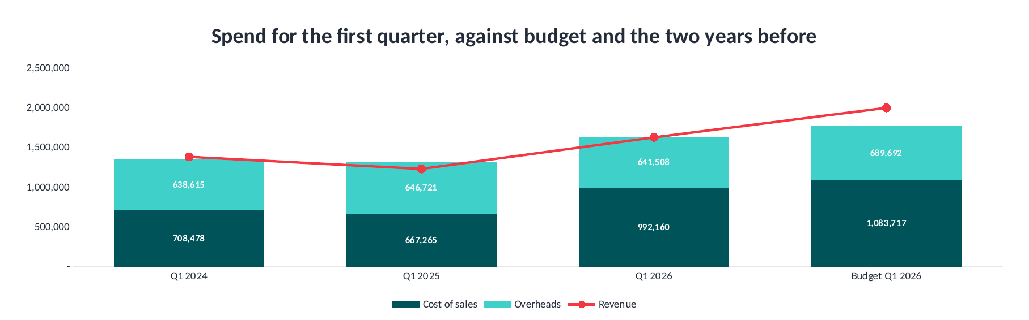
FINANCIAL PERFORMANCE
Spend for the quarter, against budget
COMMENTARY
Quarter spend was $1,634k against a budget of $1,773k, $140k under.
Overheads have barely moved in three years: $639k, $647k and $642k.
All the movement is cost of sales, up $325k on last year to $992k.
Revenue sat above spend in Q1 2024 and below it in both years since.
Notes:
Spend for the first quarter across three years and against budget, taken from the Xero History tab.
Q1 2026 $1,633,668. Budget $1,773,409. Q1 2025 $1,313,986. Q1 2024 $1,347,094.
The quarter is $139,742 or 7.9% under budget on spend. That is the opposite of the month, where spend ran over.
The split is the point. Overheads have been $638,615, $646,721 and $641,508 across the three first quarters, a range of $8,106 on about $640,000. The overhead base has not moved in three years. Every bit of the movement in spend is cost of sales, which went $708,478, $667,265 and $992,160, up $324,895 or 48.7% on last year.
Cost of sales rising with revenue is what should happen. Revenue rose $395,878 over the same year, so cost of sales rose $324,895 to earn it, which is a contribution of about $71,000 on the extra revenue. That is a thin return on the extra work and it is why the quarter is still a loss.
The red line is revenue. In Q1 2024 it sat above the spend bar and the quarter made money. In Q1 2025 and Q1 2026 it sat below and both lost money. The budget line has revenue well clear of spend, which is how it was built to make $223,000.
FY25 comes from Xero, pulled 22 October 2026. The quarter is July to September, so it is fixed rather than following Setup.

Slide 14
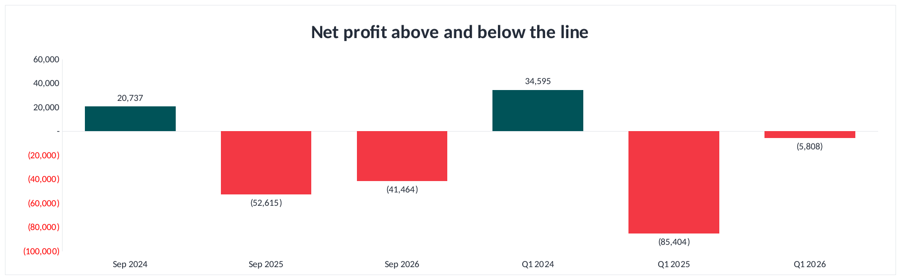
FINANCIAL PERFORMANCE
Net profit above and below the line
COMMENTARY
September lost $41k. Last September lost $53k. The September before made $21k.
The quarter lost $6k, against a $85k loss last year and a $35k profit the year before.
The quarter is $80k better than last year and close to breakeven.
It is still $229k below budget, which had the quarter at a $223k profit.
Notes:
Net profit above and below the line, the reporting month and the first quarter across three years, taken from the Xero History tab. Net profit is the pack's own figure and includes other income.
The month: September 2026 a loss of $41,464, September 2025 a loss of $52,615, September 2024 a profit of $20,737.
The quarter: Q1 2026 a loss of $5,808, Q1 2025 a loss of $85,404, Q1 2024 a profit of $34,595.
Two readings come out of this and they point in opposite directions.
The first is that the business has been below the line for two years. Five of the six bars on this chart are losses or near enough, and the only two profits are both FY25. Whatever else the numbers say, September and the first quarter have not made money since FY25.
The second is that the direction is right. The quarter has improved $79,596 on last year and is within $5,808 of breaking even. The month is $11,152 better than the same month last year. On revenue alone the business is billing a third more than it did a year ago.
What stops that being good news is the plan. The budget had the first quarter at a $222,700 profit. Coming in at a $5,808 loss is $228,508 below it. The business has recovered most of the ground it lost in FY26 and is still a long way from the year it was asked to deliver.
FY25 was pulled from Xero on 22 October 2026. Only the first quarter of FY25 was pulled, so the FY25 bar on the monthly side is blank from October onward until the rest is pulled.

Slide 15
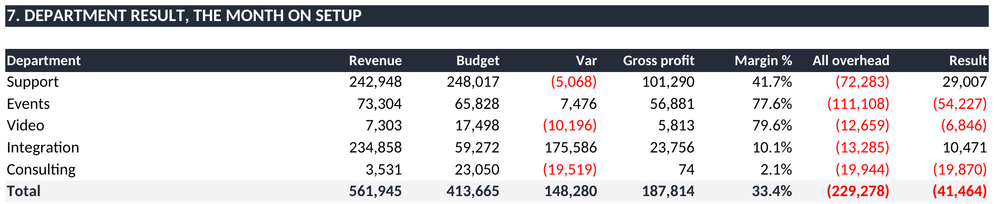
FINANCIAL PERFORMANCE
Department result, Sep 26
COMMENTARY
Support generated a $29k profit on $243k revenue after its allocated overheads.
Events achieved a 78% gross margin, but recorded a $54k loss after $111k in allocated overheads and $73k revenue.
Integration delivered $235k revenue against a $59k budget. A 10% gross margin limited the final profit to $10k.
Consulting generated $4k revenue against approximately $20k of overheads. Its operating model and cost allocation require review.
Notes:
Each department against budget, carrying its full overhead charge, taken from section 7 of the Overhead Split tab.
Support: revenue $242,948 against a $248,017 budget. Gross profit $101,290 at 41.7%. Overhead $72,283, of which $59,182 is allocated admin. Result $29,007.
Events: revenue $73,304 against $65,828. Gross profit $56,881 at 77.6%. Overhead $111,108, of which $71,672 is allocated admin. Result a loss of $54,227.
Video: revenue $7,303 against $17,498. Gross profit $5,813 at 79.6%. Overhead $12,659, of which $9,782 is allocated admin. Result a loss of $6,846.
Integration: revenue $234,858 against $59,272. Gross profit $23,756 at 10.1%. Overhead $13,285, of which $4,148 is allocated admin. Result $10,471.
Consulting: revenue $3,531 against $23,050. Gross profit $74 at 2.1%. Overhead $19,944, of which $13,979 is allocated admin. Result a loss of $19,870.
The five departments total a loss of $41,464, which is net profit for the month.
Two observations. Integration sold $175,586 more than planned and it produced very little profit, because the margin retained on resold equipment is 10.1%. And Events carries $71,672 of office costs on $73,304 of sales. That charge is allocated on office usage, and Events is not the department occupying the office. I would suggest the allocation basis is reviewed for FY28 rather than changed mid-year.

Slide 16
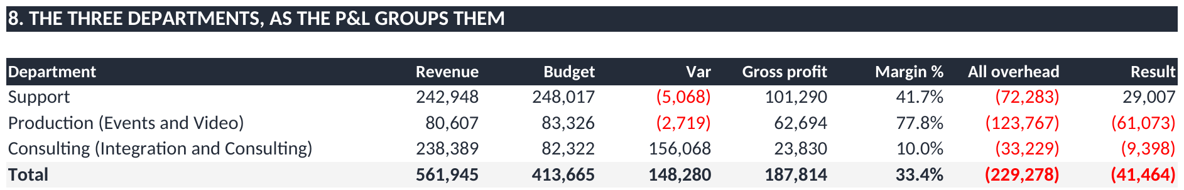
FINANCIAL PERFORMANCE
The three departments, Sep 26
COMMENTARY
The P&L groups Events and Video under Production, and Integration and Consulting under Consulting.
Support generated $29k profit on $243k revenue and is the only major group covering its allocated overheads.
Production achieved a 78% gross margin on $81k revenue, but recorded a $61k loss after $124k of overheads.
The combined Consulting group generated $238k revenue against an $82k budget. Its 10% gross margin contributed to a $9k loss.
Notes:
The same month read as three departments rather than five, which is how the Summary tab is constructed.
Production is the parent of Events and Video. Consulting is the parent of Integration and Consulting. Support has no sub-departments. Admin is not a trading department and its costs are allocated across the three.
Support: revenue $242,948 against a $248,017 budget. Gross profit $101,290 at 41.7%. All overhead $72,283. Result $29,007.
Production: revenue $80,607 against $83,326. Gross profit $62,694 at 77.8%. All overhead $123,767. Result a loss of $61,073.
Consulting: revenue $238,389 against $82,322. Gross profit $23,830 at 10.0%. All overhead $33,229. Result a loss of $9,398.
The three total a loss of $41,464, which is net profit for the month, and the check row on the tab reconciles it to the five department view.
The grouping shows something the five departments did not. Production, being Events and Video together, retains 77.8% of what it sells, the strongest margin in the business. It records a loss only because it carries $123,767 of running costs against $80,607 of sales. That is a volume position rather than a pricing one, and it presents the clearest growth case in the pack.
The Consulting group is the opposite. It sold $156,068 more than plan and retains 10.0%, because almost all of that was resold equipment through Integration. Additional sales of that kind would not improve the result.
Support carries the profit of the business. On these three lines the questions are how Support is protected, how Production is given volume, and how Consulting is resolved.

Slide 17
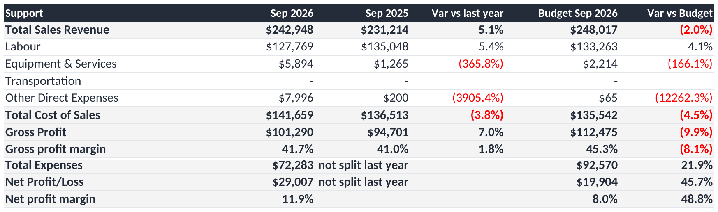
FINANCIAL PERFORMANCE
Support, Sep 26
COMMENTARY
Support generated $243k revenue against a $248k budget, broadly in line with expected recurring contract income.
Gross margin was 41.7%, compared with 41.0% in September last year.
After $72k of allocated overheads, Support recorded a $29k profit.
Its allocated office wages were $42k, reflecting the established allocation method.
Chargeable utilisation reached 91.2%, above the 88% target and the strongest result across the groups.
Notes:
Support for September 2026, taken from the Dept P&L tab.
Revenue $242,948 against a budget of $248,017, behind by $5,068. September last year was $231,214.
After direct costs of $141,659 it retained $101,290, being 41.7% of revenue.
Overheads charged to it were $72,283, of which $13,101 is its own spending and $59,182 is its share of the office, allocated on the keys set in the pack.
That leaves $29,007 for the month.
Year to date it has billed $718,587 against a budget of $743,185.
On people, employment expense of $51,242, of which $8,980 is its own staff and $42,262 its share of office wages. It recorded 2,132 billable hours and 11 non-billable, with 218 hours of leave.

Slide 18
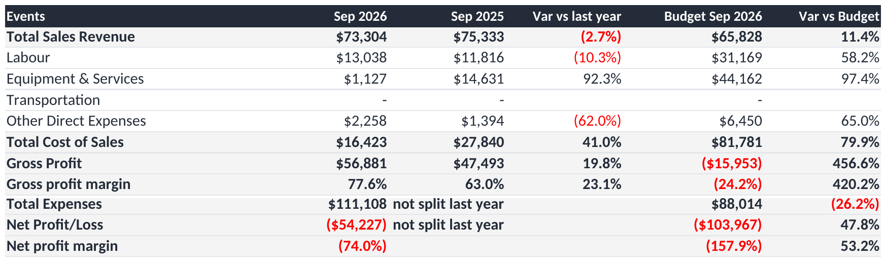
FINANCIAL PERFORMANCE
Events, Sep 26
COMMENTARY
Events generated $73k revenue against a $66k budget for September.
Gross margin was 77.6%, a strong result compared with other departments.
Despite this, Events recorded a $54k loss after $111k of allocated overheads.
Approximately $72k relates to shared overhead allocations. The allocation basis should be reviewed to confirm it appropriately reflects departmental activity.
The team recorded 333 hours of leave and 241 billable hours, highlighting reduced available delivery capacity.
Notes:
Events for September 2026, taken from the Dept P&L tab.
Revenue $73,304 against a budget of $65,828, ahead by $7,476. September last year was $75,333.
After direct costs of $16,423 it retained $56,881, being 77.6% of revenue.
Overheads charged to it were $111,108, of which $39,436 is its own spending and $71,672 is its share of the office.
That leaves a loss of $54,227 for the month.
Year to date it has billed $420,121 against a budget of $321,957.
On people, employment expense of $50,959, of which $35,665 is its own staff and $15,294 its share of office wages. It recorded 241 billable hours and 249 non-billable, with 333 hours of leave.
The department earns the second strongest margin in the business and still records a loss, because the overhead allocated to it is larger than its revenue. I would suggest the allocation basis is the item to examine here, alongside the leave taken in the month.

Slide 19
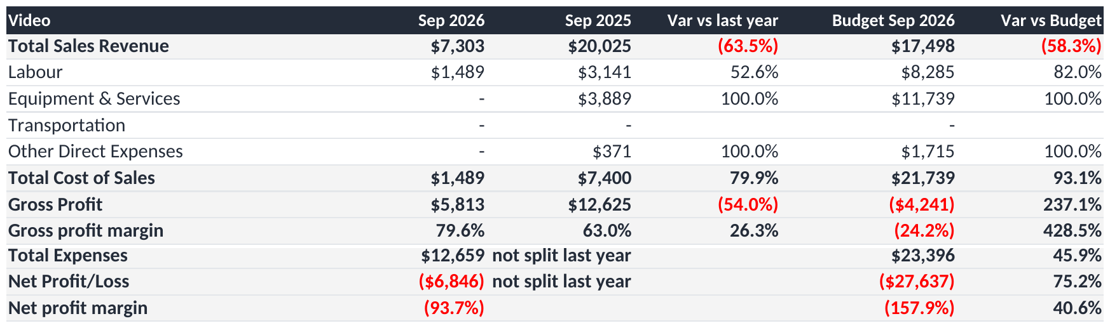
FINANCIAL PERFORMANCE
Video, Sep 26
COMMENTARY
Video generated $7k revenue against a $17k budget, marking a third consecutive month below plan.
Gross margin was 79.6%, the highest of the departments.
However, this produced only $6k in gross profit against approximately $13k of overheads.
The main challenge is the volume of billable work rather than the gross margin percentage.
Only 24.5 billable hours were recorded for September, indicating limited activity.
Notes:
Video for September 2026, taken from the Dept P&L tab.
Revenue $7,303 against a budget of $17,498, behind by $10,196. September last year was $20,025.
After direct costs of $1,489 it retained $5,813, being 79.6% of revenue.
Overheads charged to it were $12,659, of which $2,878 is its own spending and $9,782 is its share of the office.
That leaves a loss of $6,846 for the month.
Year to date it has billed $40,270 against a budget of $85,584.
On people, employment expense of $3,961, of which $2,660 is its own staff and $1,301 its share of office wages. It recorded 25 billable hours and 8 non-billable, with no leave.
The margin is the highest in the business. The constraint is the volume of billable work, which at 25 hours for the month is well below the level the budget assumed.

Slide 20
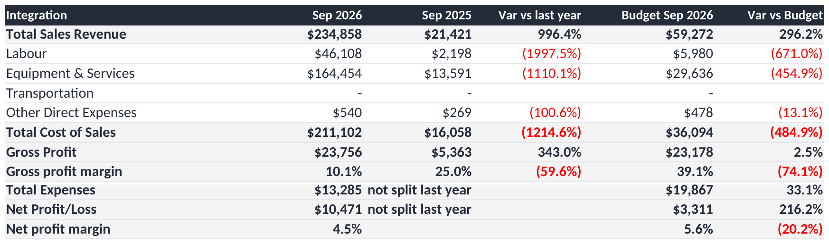
FINANCIAL PERFORMANCE
Integration, Sep 26
COMMENTARY
Integration generated $235k revenue against a $59k budget, largely from a completed installation project.
Gross margin was 10.1%, reflecting the high equipment and supplier costs associated with the work.
This resulted in approximately $24k gross profit, despite the strong revenue result.
After $13k of overheads, Integration reported a $10k profit.
Only 10 billable hours were recorded, indicating that the revenue was mainly driven by equipment supply rather than labour delivery.
Notes:
Integration for September 2026, taken from the Dept P&L tab.
Revenue $234,858 against a budget of $59,272, ahead by $175,586. September last year was $21,421.
After direct costs of $211,102 it retained $23,756, being 10.1% of revenue.
Overheads charged to it were $13,285, of which $9,136 is its own spending and $4,148 is its share of the office.
That leaves $10,471 for the month.
Year to date it has billed $441,414 against a budget of $608,676.
On people, employment expense of $8,832, of which $8,563 is its own staff and $269 its share of office wages. It recorded 10 billable hours and no non-billable time.
The revenue came from a single completed installation rather than from recurring work, and from equipment supply rather than labour, which is why 10 billable hours sit behind $235k of sales. I would treat the result as timing rather than as a change in run rate.

Slide 21
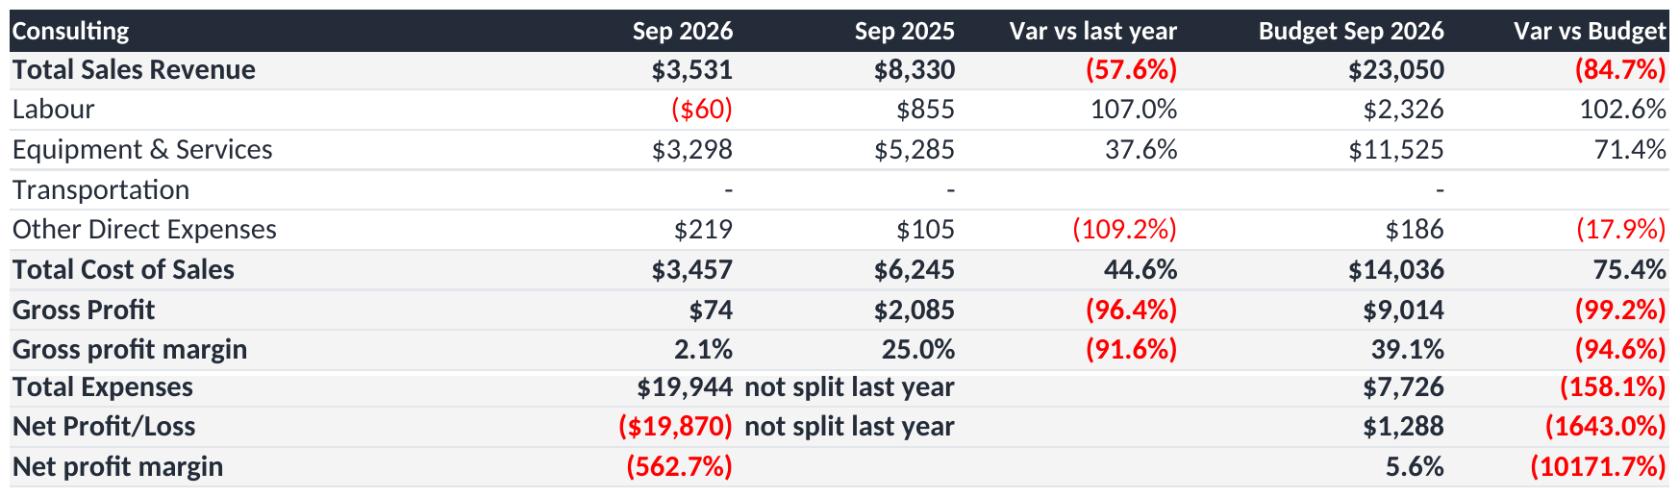
FINANCIAL PERFORMANCE
Consulting, Sep 26
COMMENTARY
Consulting generated $4k revenue against a $23k budget, reflecting limited fee-generating activity.
The department recorded a $20k loss after approximately $20k of overheads.
Non-billable activity totalled 84 hours, compared with 31 billable hours.
Year-to-date revenue is $4k against a $237k budget.
Management should review the department's future structure, capacity and commercial viability, including whether to rebuild or combine its activities.
Notes:
Consulting for September 2026, taken from the Dept P&L tab.
Revenue $3,531 against a budget of $23,050, behind by $19,519. September last year was $8,330.
After direct costs of $3,457 it retained $74, being 2.1% of revenue.
Overheads charged to it were $19,944, of which $5,965 is its own spending and $13,979 is its share of the office.
That leaves a loss of $19,870 for the month.
Year to date it has billed $4,068 against a budget of $236,707.
On people, employment expense of $9,496, of which $5,545 is its own staff and $3,951 its share of office wages. It recorded 31 billable hours and 84 non-billable, with 53 hours of leave.
The department has carried running costs against almost no fee income for three consecutive months. I would suggest its structure, capacity and commercial basis are reviewed, including whether the work is better delivered within Integration.

Slide 22
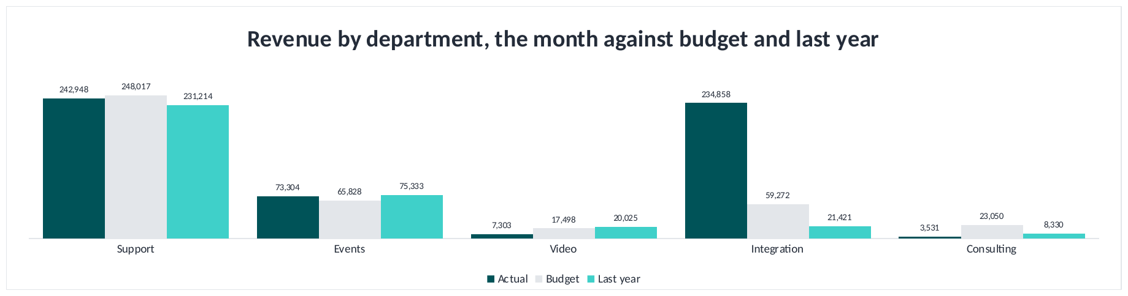
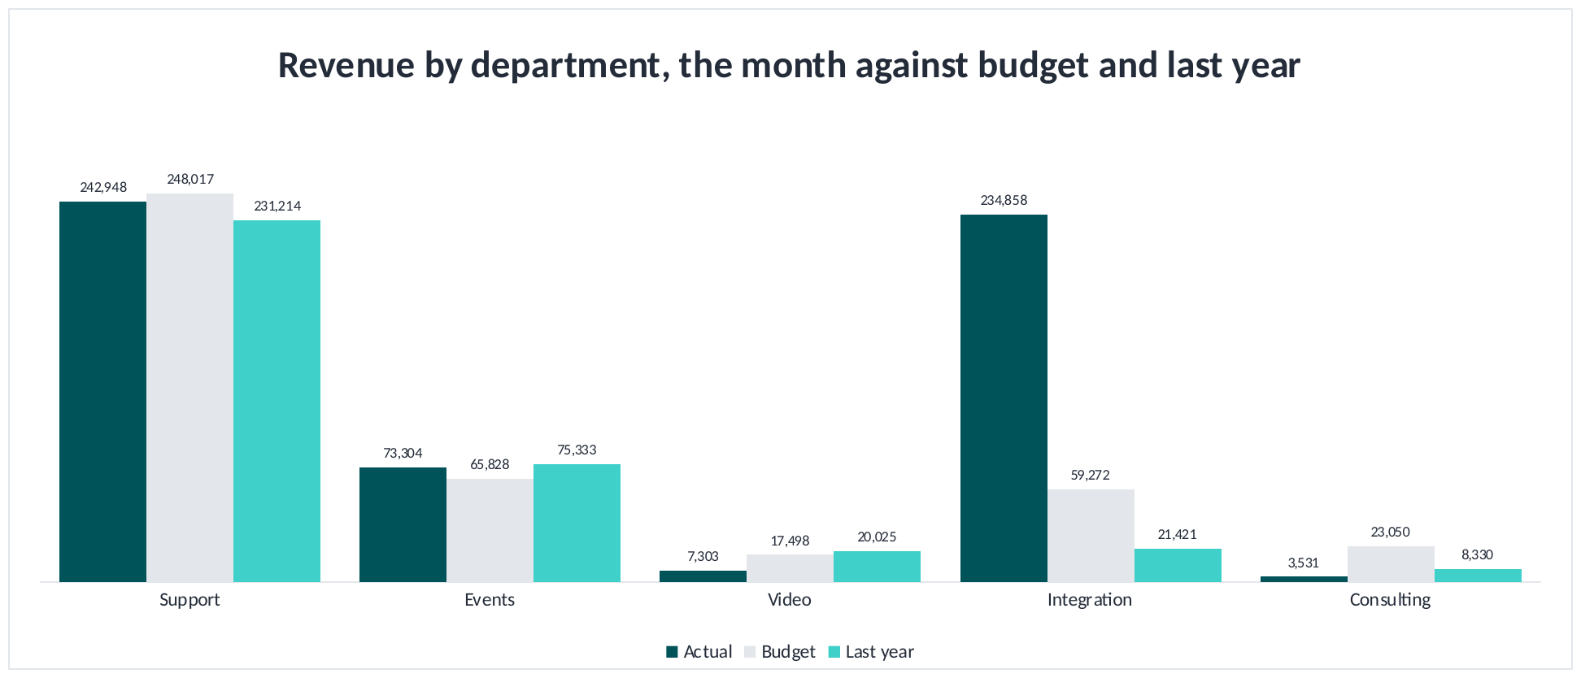
FINANCIAL PERFORMANCE
Revenue against budget and last year
COMMENTARY
Integration generated $235k revenue against a $59k budget, mainly from a completed installation project. This result may not recur in October.
Support recorded $243k revenue against a $248k budget, remaining broadly in line with recurring contracts.
Events delivered $73k revenue against a $66k budget.
Video recorded $7k against $17k, and Consulting $4k against $23k. Both remain below budget for the third consecutive month.
Total revenue increased 58% against September last year, although the gross margin percentage declined.
Notes:
Revenue by department for September 2026, actual against budget and against the same month last year.
Support: $242,948 against a budget of $248,017 and $231,214 last year.
Integration: $234,858 against a budget of $59,272 and $21,421 last year.
Events: $73,304 against a budget of $65,828 and $75,333 last year.
Video: $7,303 against a budget of $17,498 and $20,025 last year.
Consulting: $3,531 against a budget of $23,050 and $8,330 last year.
Company revenue of $561,945 against a $413,665 budget and $356,323 in September last year.
The variance to budget is almost entirely Integration, and it represents one large fit-out at a 10.1% gross margin. It is better read as timing than as growth. Video and Consulting are below budget for the third consecutive month.

Slide 23
SECTION
02
What we spend
Where the money goes and which lines move
Notes:
Running costs are steady at approximately $214k a month. Spending is not the cause of the result, but it is the figure revenue has to cover.

Slide 24
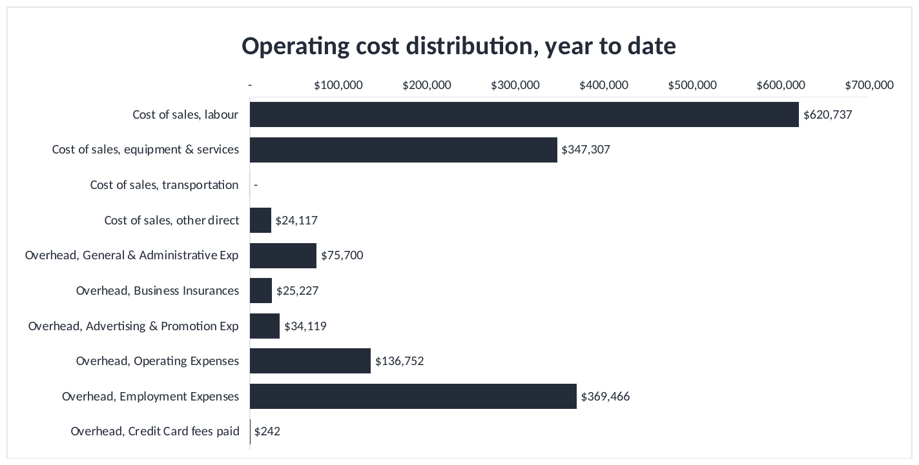
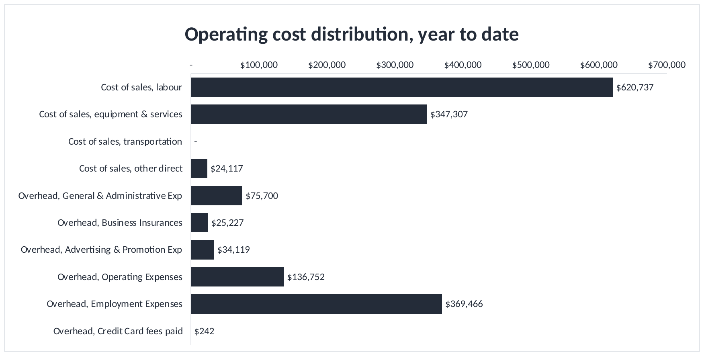
WHAT WE SPEND
Operating cost distribution, year to date
COMMENTARY
Year-to-date direct labour costs total $621k, with a further $369k in employment overheads. Together, these represent a substantial share of total costs.
Labour is the largest cost category and has a major impact on profitability.
Much of the employment overhead is relatively fixed in the short term, even when revenue fluctuates.
Equipment and services costs of $347k are more closely linked to project activity.
Material cost reductions would require a review of staffing capacity, utilisation and premises costs, while maintaining service delivery.
Notes:
Operating cost distribution for the year to date, with cost of sales and overhead shown on one scale.
Cost of sales, labour $620,737 at 38.0%. Cost of sales, equipment and services $347,307 at 21.3%. Cost of sales, other direct $24,117 at 1.5%. Overhead, general and administrative $75,700 at 4.6%. Overhead, business insurances $25,227 at 1.5%. Overhead, advertising and promotion $34,119 at 2.1%. Overhead, operating expenses $136,752 at 8.4%. Overhead, employment expenses $369,466 at 22.6%.
The concentration is the point. Wages for staff on jobs and wages for everyone else make up the bulk of the cost base, and the second group is largely fixed within the year, which is why a quieter month passes straight to the result.
If the question is where costs can be reduced, the honest answer is headcount or premises. Reductions in subscriptions and travel would not change this picture materially.

Slide 25
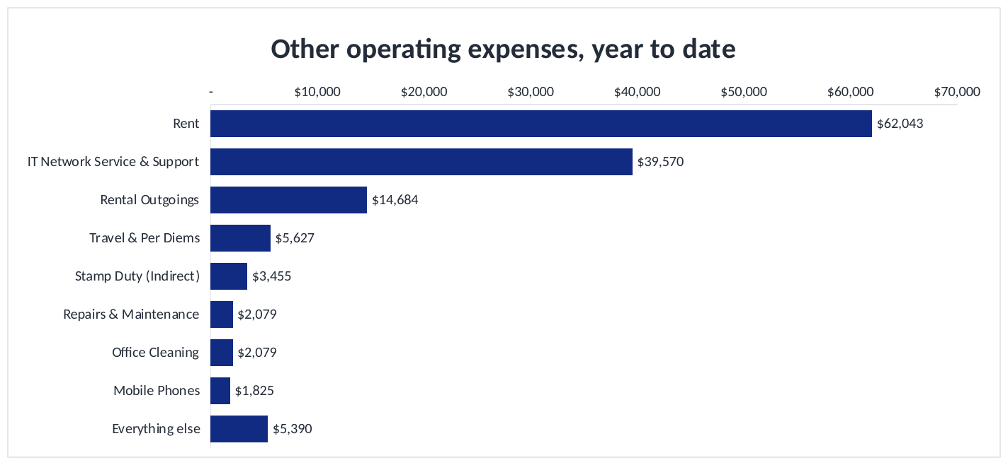

WHAT WE SPEND
Other operating expenses, year to date
COMMENTARY
Rent and property outgoings total approximately $77k year to date, making premises the largest expense in this category.
IT network support is the next largest cost at approximately $40k.
Most remaining individual categories are below $6k for the quarter.
Smaller expense reductions may help, but are unlikely to materially change overall profitability.
Any substantial saving in this category would require a review of premises and lease commitments.
Notes:
Other operating expenses for the year to date.
Rent $62,043 at 45.4%. IT network service and support $39,570 at 28.9%. Rental outgoings $14,684 at 10.7%. Travel and per diems $5,627 at 4.1%. Stamp duty, indirect, $3,455 at 2.5%. Repairs and maintenance $2,079 at 1.5%. Office cleaning $2,079 at 1.5%. Mobile phones $1,825 at 1.3%. All other items $5,390 at 3.9%.
Rent and outgoings are fixed by the lease. IT support is the next largest and the only item that moves with activity.
The practical conclusion is that savings of any size do not come from this category. A material reduction would require a discussion about the office lease.

Slide 26
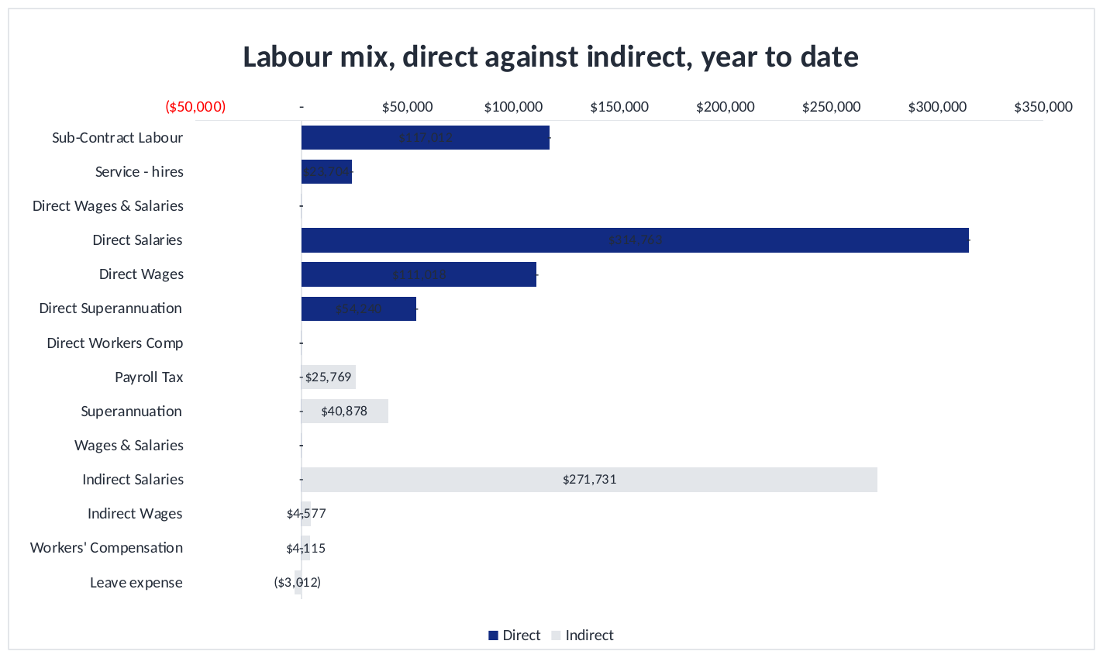
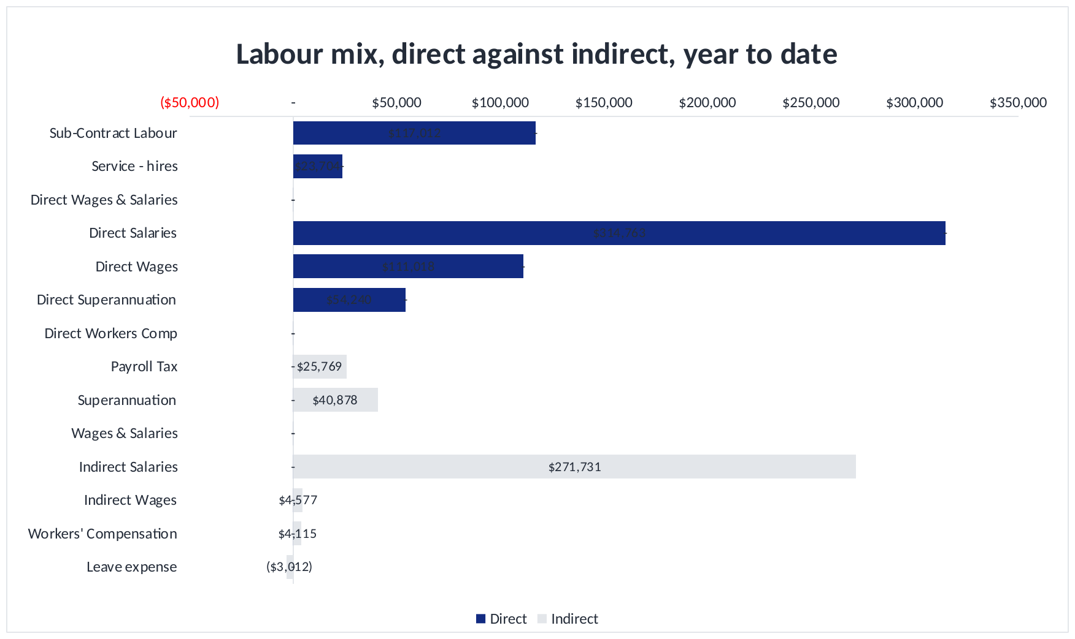
WHAT WE SPEND
Labour mix, year to date
COMMENTARY
Direct labour consists of employee costs and external contractors or service hires.
Employee salaries, wages and superannuation account for most direct labour costs.
Contractor spending generally changes with project demand and resourcing requirements.
Reviewing contractor costs alongside staff utilisation will help identify opportunities to use existing capacity.
Improving the proportion of working hours that can be billed is important for protecting margins.
Notes:
Labour mix for the year to date, direct labour charged to cost of sales split by type.
Sub-contract labour $117,012. Service hires $23,704. Direct salaries $314,763. Direct wages $111,018. Direct superannuation $54,240.
The majority is permanent payroll. Contractors are the only labour cost that rises and falls with the work.
This is the link to the utilisation section. The business pays for hours worked and invoices for hours that are chargeable, and margin follows the difference between the two.

Slide 27
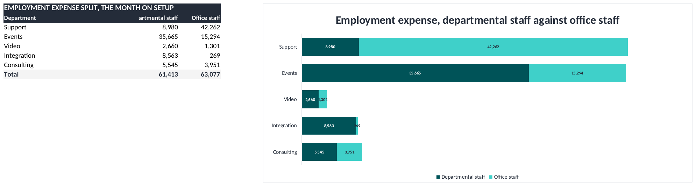
WHAT WE SPEND
Employment expense, office and departmental
COMMENTARY
Office employment costs totalled $63,077 in September and were allocated across departments.
Support received approximately 67% of the allocation under the rolling-hours methodology.
Events incurred $35,665 in direct departmental employment costs, alongside $15,294 in allocated office wages.
Integration was allocated $269 in office wages, reflecting its comparatively low share under the allocation methodology.
Notes:
Employment expense split between office staff and departmental staff for September 2026.
Departmental staff is the employment expense on each department's own cost centre: Support $8,980, Events $35,665, Video $2,660, Integration $8,563, Consulting $5,545.
Office staff is the admin employment pot of $63,077, allocated across the departments on their share of full time equivalent: Support $42,262, Events $15,294, Video $1,301, Integration $269, Consulting $3,951.
Full time equivalent is rolling twelve month worked hours on that cost centre divided by 2,024 hours, being 253 working days at eight hours. That is the method set out in the training material.
The change worth noting is that this allocation no longer depends on a figure typed in by hand. The pack calculates it from the Labour Hours Report, so it reproduces each month without a judgement being made.

Slide 28
SECTION
03
Customers and cash
Who pays us, how much, and how slowly
Notes:
Revenue is concentrated and cash is slow. Days sales outstanding is 47.2 days against a 30 day target, which represents $303,605 of cash held in the receivables book above where it should be.

Slide 29
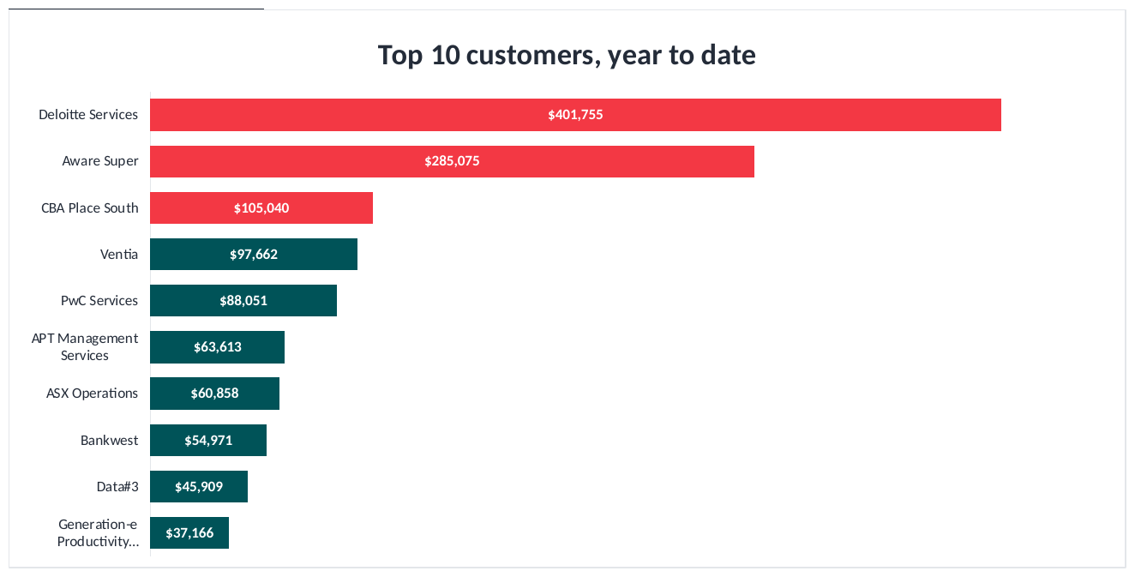

CUSTOMERS AND CASH
Top ten customers, year to date
COMMENTARY
The top three customers account for approximately 49% of year-to-date revenue.
The top ten contribute 76%, leaving 24% from all other customers combined.
Deloitte Services represents approximately 25% of revenue at $402k, creating significant customer concentration risk.
Aware Super contributed $285k during the quarter, mainly from a one-off September project.
Revenue drops considerably beyond the largest customers, highlighting the importance of growing the wider customer base.
Notes:
The ten largest customers by revenue for the year to date, with the top three highlighted.
1. Deloitte Services: $401,755 for the year, 24.7% of the total, $119,614 of it in September.
2. Aware Super: $285,075 for the year, 17.5% of the total, $241,178 of it in September.
3. CBA Place South: $105,040 for the year, 6.5% of the total, $30,409 of it in September.
4. Ventia: $97,662 for the year, 6.0% of the total, $9,105 of it in September.
5. PwC Services: $88,051 for the year, 5.4% of the total, $26,707 of it in September.
6. APT Management Services: $63,613 for the year, 3.9% of the total, $4,527 of it in September.
7. ASX Operations: $60,858 for the year, 3.7% of the total, $17,167 of it in September.
8. Bankwest: $54,971 for the year, 3.4% of the total, $17,230 of it in September.
9. Data#3: $45,909 for the year, 2.8% of the total, none in September.
10. Generation-e Productivity Solutions: $37,166 for the year, 2.3% of the total, $12,389 of it in September.
The ten together represent $1,240,100, or 76.3% of total revenue. Every other customer accounts for the remaining $384,360. The three highlighted customers are 48.7% of the year between them.
The distinction that matters is contracted work against one-off projects. Deloitte Services is contracted support that renews monthly. Aware Super is a fit-out that has now completed. Treating the two as the same kind of income is how a forecast goes wrong.
I would suggest a named relationship owner for each of the top three before the half year, and that the new business target is set on customers four to twenty rather than on the accounts the business already holds.

Slide 30
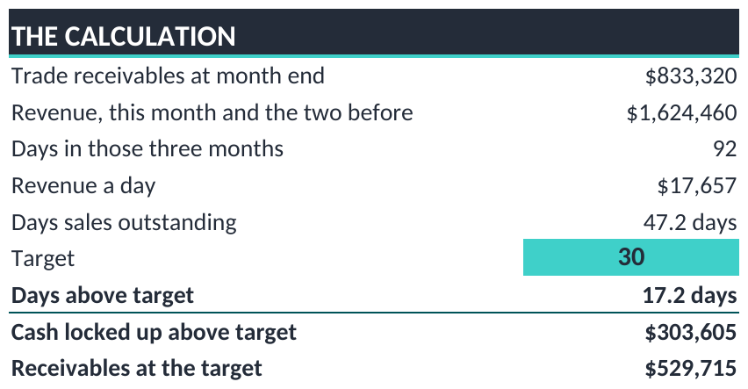
CUSTOMERS AND CASH
How long customers take to pay
COMMENTARY
Days sales outstanding is 47.2 days, compared with a target of 30 days.
This represents approximately 17 additional days of revenue tied up in receivables.
At the current revenue rate, closing the gap could release approximately $304k in working capital.
Each day of improvement is equivalent to approximately $17.7k in receivables at the current sales rate.
Collections should remain a short-term cash-flow priority, with focus on larger outstanding balances.
Notes:
Days sales outstanding at 30 September 2026.
Receivables are $833,320. Over the last three months the business sold $1,624,460, which across 92 days is $17,657 of sales a day. On that basis customers are taking 47.2 days to pay.
The target is 30 days, so the book is 17.2 days over. Collected on time, receivables would be $529,715 rather than $833,320, leaving $303,605 of cash in the book that should already be with the business.
Set against the result, the quarter produced $5,774 of EBITDA while $303,605 remains uncollected. Collection is worth considerably more this quarter than any trading improvement available in the time, and it requires no additional cost.
Each day removed from the figure returns approximately $17,657.

Slide 31
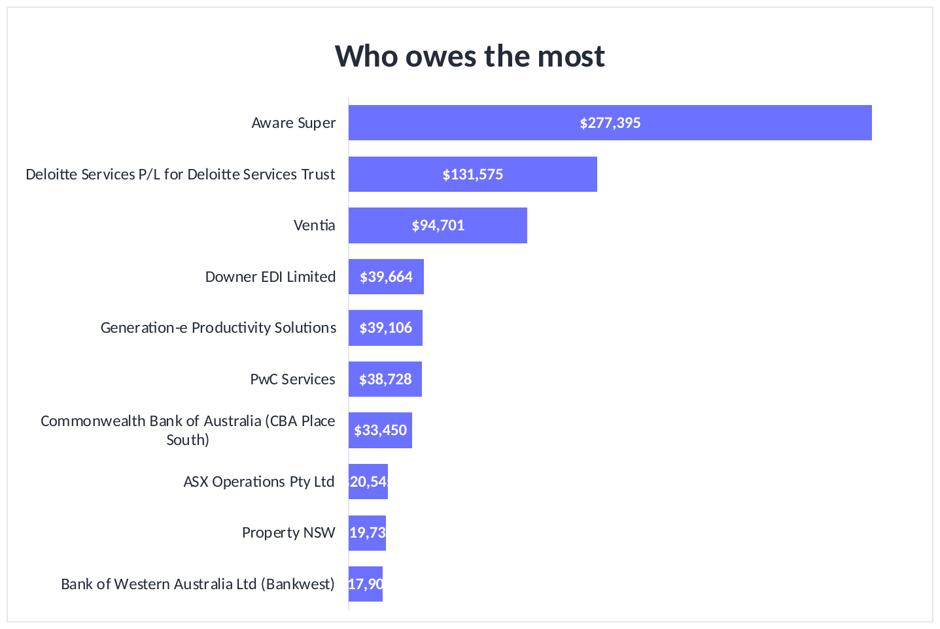
CUSTOMERS AND CASH
Who owes us the most
COMMENTARY
Aware Super has an outstanding balance of $277k, representing 33% of total receivables.
Together with Deloitte Services P/L for Deloitte Services Trust at $132k, the two account for approximately 49% of receivables.
Overdue amounts total approximately $245k, or 29% of the debtor balance.
Collections efforts should prioritise these larger accounts while maintaining follow-up on other overdue invoices.
A targeted collections plan with clear owners and follow-up dates is likely to be more effective than a broad reminder process alone.
Notes:
The ten largest amounts owed at 30 September 2026.
Aware Super: $277,395, 33.3% of the total.
Deloitte Services P/L for Deloitte Services Trust: $131,575, 15.8%.
Ventia: $94,701, 11.4%.
Downer EDI Limited: $39,664, 4.8%.
Generation-e Productivity Solutions: $39,106, 4.7%.
The ageing profile is current $588,782 at 70.7%, under one month $133,177 at 16.0%, one month $86,553 at 10.4%, and three months $24,809 at 3.0%. Overdue in total $244,538, or 29.3% of the book.
Two customers hold most of the balance, so a targeted approach to those accounts would be more productive than a general collections exercise, and it represents the fastest cash available to the business this quarter.

Slide 32
SECTION
04
People and utilisation
Chargeable hours and the profit they produce
Notes:
The company invoiced 2,438 hours in September 2026 out of 3,395 it was available for, which is 72%. Where chargeable hours fall short, margin follows.

Slide 33
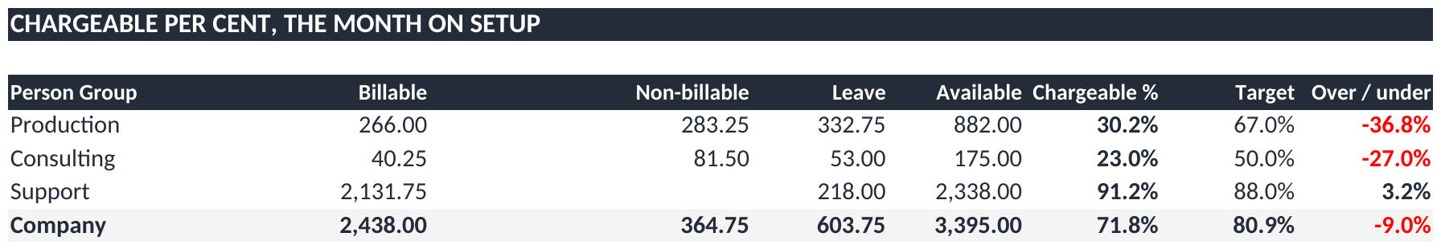
PEOPLE AND UTILISATION
Chargeable per cent, Sep 26
COMMENTARY
Chargeable utilisation is calculated as billable hours divided by workable business hours, including leave in the available-hours base.
Support achieved 91.2% against an 88.0% target, exceeding the target by 3.2 percentage points.
Production achieved 30.2% against a 67.0% target. Leave represented approximately 38% of its available hours.
Overall utilisation was 71.8% against an 80.9% target, a shortfall of 9.0 percentage points.
Notes:
Chargeable per cent for September 2026, calculated on the same basis as the monthly Utilisation Report.
The measure is billable hours divided by workable business hours, being the hours each person was available for in the month. Leave and public holidays remain in the denominator, so a team taking its leave entitlement shows a lower percentage. That is the business's own definition and the pack now follows it.
Support 91.2% against an 88.0% target, 3.2 points over. Production 30.2% against 67.0%, 36.8 points under. Consulting 23.0% against 50.0%, 27.0 points under. The company 71.8% against 80.9%, 9.0 points under.
Support has exceeded its target in all three closed months, by 1.4, 5.8 and 3.2 points.
Leave explains the Production position: 333 hours out of 882 available, being 37.7% of the month. Across the company, leave accounted for 17.8% of available hours against 7.5% in August.
The report shows three person groups rather than five, because it groups by the department a person belongs to and nobody is assigned to Video or Integration. Their work is carried out by Production and Consulting staff.
On sources, workable business hours and the target are both entered from the report, as neither can be derived in the pack: the first requires each group's headcount and part time arrangements, and the second is set per person and averaged. The over or under reading and the leave share are calculated and reproduce the report's own columns. The three month history is held on the Utilisation tab with two reconciliation rows against the report's grand total.
One correction to note for completeness. An earlier version of this pack divided billable hours by hours actually worked, excluding leave, which showed Support at 99.5% and gave the appearance of a coding error. That was a difference in method rather than a problem with the data.
OT and TIL is reported but is not carried in the pack. The August figure for Support reads 365.62, which cannot represent hours in a month, so that column would benefit from review on the source report before it is relied upon.

Slide 34
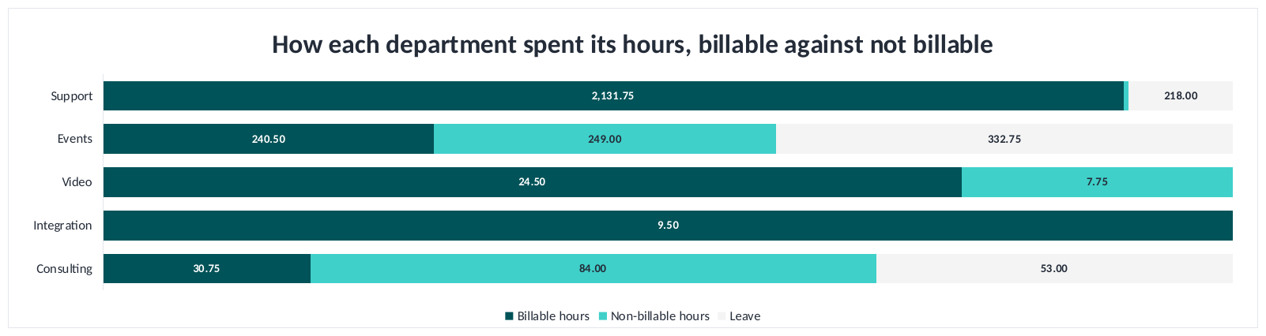
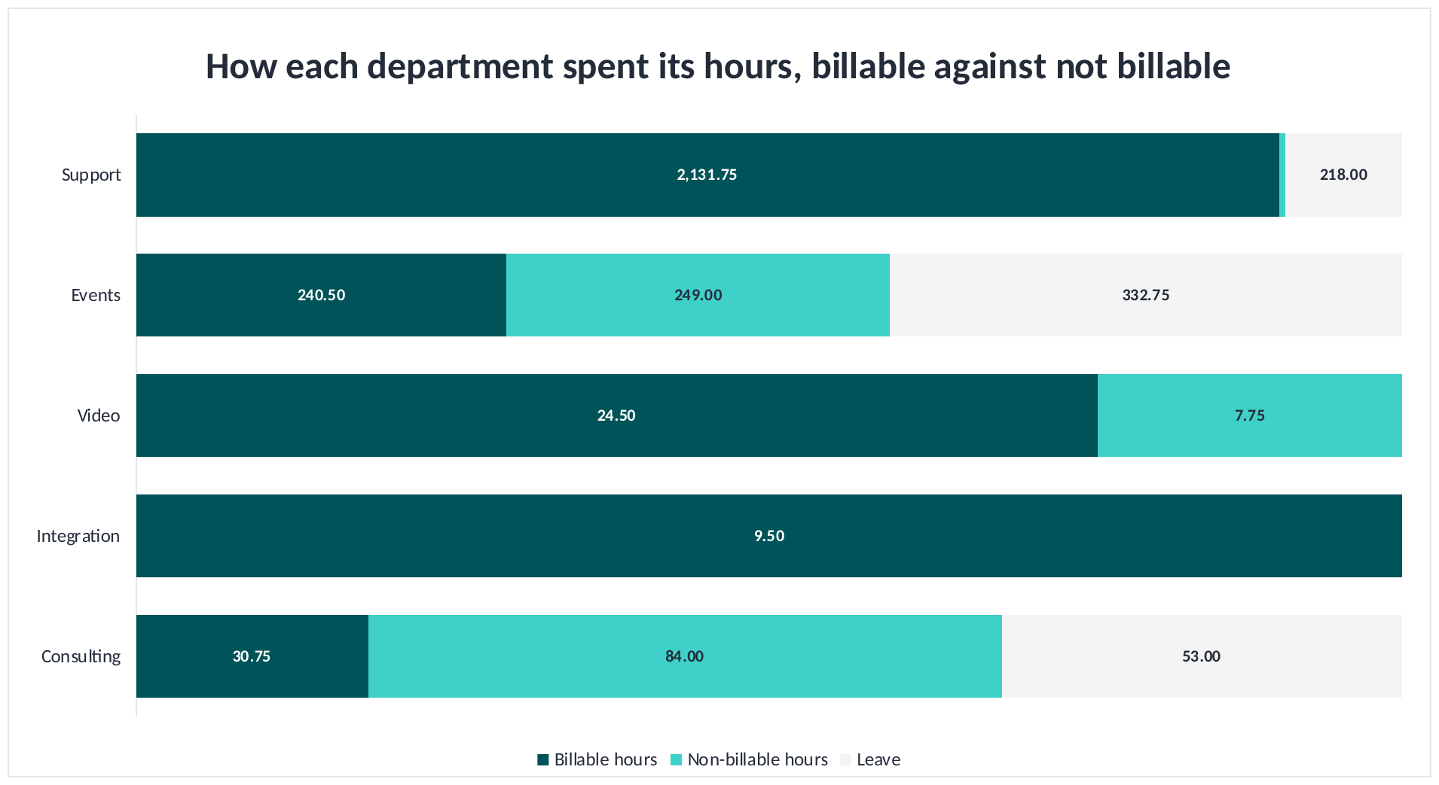
PEOPLE AND UTILISATION
How each department spent its hours, Sep 26
COMMENTARY
Each bar shows the mix of hours within its own department, rather than comparing total hours between departments.
Support's hours were predominantly billable, supporting its positive financial result.
Events recorded 333 hours of leave and 241 billable hours, reducing its available delivery capacity.
Consulting recorded 84 non-billable hours compared with 31 billable hours.
The non-billable and leave portions highlight opportunities to improve workforce planning and billable utilisation.
Notes:
How each department spent its hours in September 2026.
The bars show the mix within each department rather than its size. Each is scaled to that department's own total, because Support works around a hundred times the hours Integration does and on a common scale four of the five would not be visible. The figure on each segment is the actual hours.
Support: 2,132 hours on jobs, 11 not on jobs, 218 leave.
Events: 241 hours on jobs, 249 not on jobs, 333 leave.
Video: 25 hours on jobs, 8 not on jobs, no leave.
Integration: 10 hours on jobs, none off jobs, no leave.
Consulting: 31 hours on jobs, 84 not on jobs, 53 leave.
Across the five departments, 2,437 hours on jobs out of 2,789 worked.
On the Support bar, the small non-billable segment arises from the regrouping rather than from coding. The monthly report shows Support with no non-billable hours in September. This view groups by the department the work was performed for, so a small amount of other staff's non-billable time appears here.
Events is the clearest operational position on this slide: 333 hours of leave on a small team removes most of the month's capacity.
There is also an opportunity worth quantifying. Support earns approximately $48 of margin on each hour it invoices. Five additional points of billable time across Support and Events, at the rates each already achieves, would be worth approximately $15,813 a month at no additional cost. It is the largest controllable item in this pack.

Slide 35
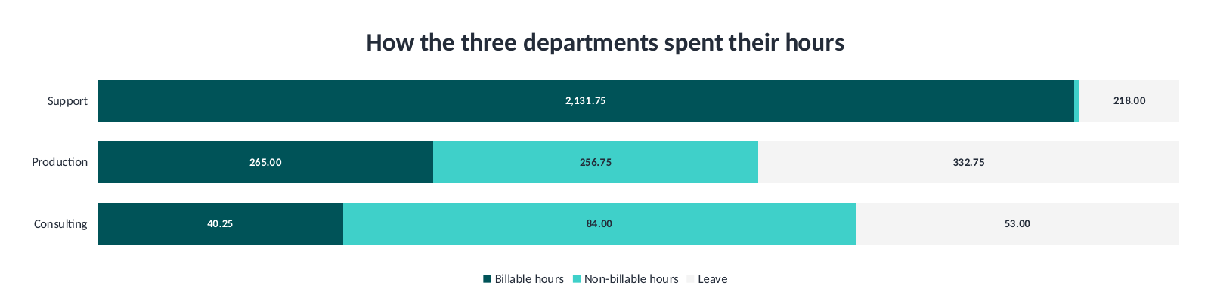
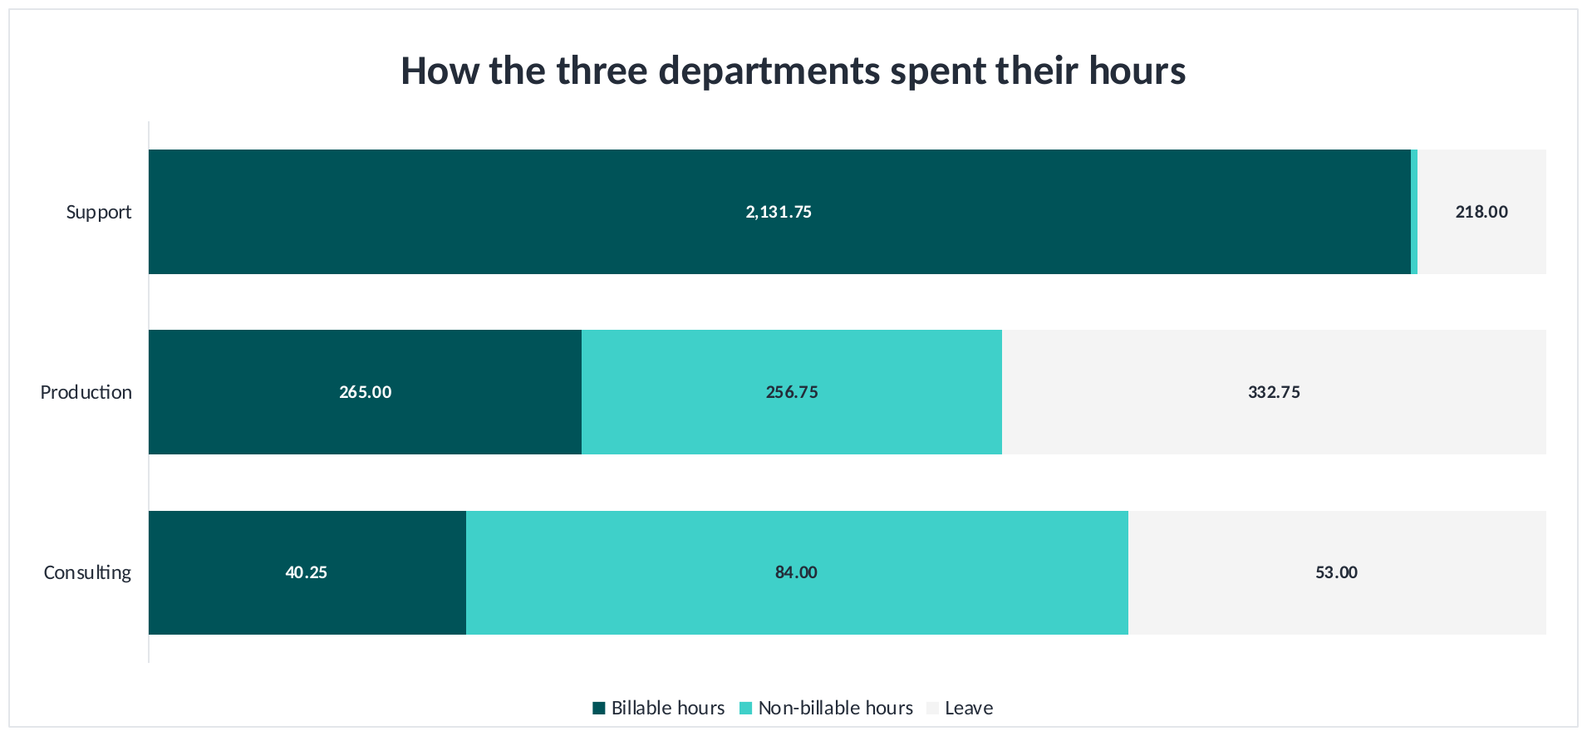
PEOPLE AND UTILISATION
Hours, the three departments, Sep 26
COMMENTARY
This view combines Events and Video as Production, and Integration and Consulting as Consulting, consistent with the P&L.
Production recorded 265 billable hours, 257 non-billable hours and 333 hours of leave.
Consulting recorded 40 billable hours and 84 non-billable hours, indicating low utilisation of available working time.
Support's hours were predominantly billable and supported the group's positive contribution.
Each bar is scaled separately, as Support has substantially more recorded hours than the other groups.
Notes:
The hours mix for September 2026, grouped as the three departments the P&L is built on.
Production is Events and Video together. Consulting is Integration and Consulting together. Support stands alone.
Each bar is scaled to its own total, as Support works considerably more hours than the other two groups combined.
The pattern underlies much of this pack. Support is almost entirely billable and is the only group covering its costs. Production and Consulting each spend around half their paid hours, or more, on work that cannot be invoiced, and both record losses.
On the monthly report's own basis, which counts leave against the measure, Support reads 91.2%. That is the figure to use in discussion.

Slide 36
SECTION
05
Budget and outlook
What the rest of the year looks like and what we change
Notes:
Three months are closed and the remaining nine remain at original budget. That is the matter before the board.

Slide 37
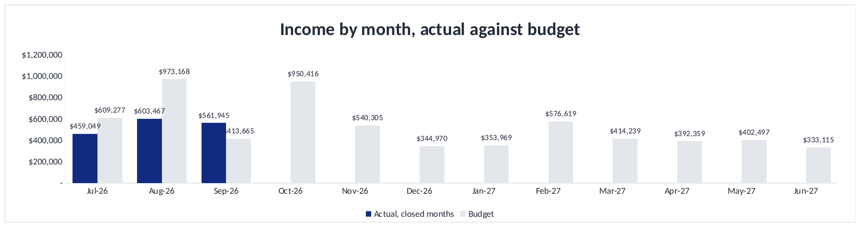
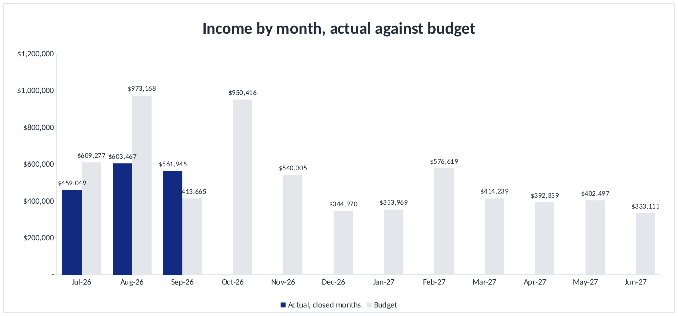
BUDGET AND OUTLOOK
Revenue by month against budget
COMMENTARY
First-quarter revenue was $372k below budget, with significant shortfalls in Consulting and Video.
October to June currently reflects the original budget rather than an updated forecast.
October revenue is budgeted at $950k, well above the highest actual month recorded so far this year.
December includes a planned loss reflecting the two-week business closure, which should remain in the revised assumptions.
Recommend preparing an updated rolling forecast using actual delivery capacity and achievable gross margins.
Notes:
Revenue by month, actual for the three closed months and original budget thereafter.
First quarter actual of $1,624,460 against a budget of $1,996,110, behind by $371,650.
The nine months from October remain at the budget set before the year began. October is budgeted at $950,416, which is higher than any month the business has delivered.
Two points for the board. The first quarter variance is concentrated in Consulting and Video, which were budgeted on a resourcing level that does not exist. And the margin assumption in the budget sits above the rate the business has delivered for two years, so a month that meets the revenue figure would still fall short on profit.
My recommendation is a rolling forecast from the second quarter, rebuilding Consulting around actual capacity and resetting gross margin to delivered rates. December would be better left as budgeted, as the business closes for two weeks and the loss is genuine.

Slide 38
SUMMARY AND ACTIONS
What we agreed
Area | Recommendation | Owner | Suggested by
P&L | That FY27 is reforecast on gross margin rather than revenue. At a 38.9% gross margin, break even requires $549k a month against the $541k currently being delivered. | GC and FOM | 31 Oct 26
Overhead keys | Events carries $111k of overhead on $73k of revenue and cannot return a profit on that basis. I would suggest the keys are tested for FY28 and left unchanged within the current year. | GC and FOM | 30 Nov 26
Consulting | $20k of running costs against $4k of fees. A decision on whether the department is rebuilt, combined with Integration or closed would be timely this quarter. | GC | 30 Nov 26
Customers | The top three customers represent 48.7% of revenue. A named retention plan for each, with the growth target set on customers four to twenty, would reduce that concentration. | GC and Sales | 14 Nov 26
Cash | Days sales outstanding is 47.2 days. Reaching 30 days would release $304k. Aware Super and Deloitte Services P/L for Deloitte Services Trust hold most of the balance. | FOM | 24 Oct 26
Utilisation | Chargeable per cent is 72% against the report's own 81% target. Five additional points across Support and Production would be worth approximately $16k a month at no additional cost. | Ops and FOM | 30 Nov 26
Leave | Production recorded 333 hours of leave on 882 available. Planning leave against the booking calendar would protect delivery capacity. | Ops | 30 Nov 26
Notes:
Seven recommendations, each with a suggested owner and date.
The first two carry the most weight: reforecasting on margin rather than revenue, and reviewing the overhead keys. Most of the pack follows from those two figures.
The Consulting position has now run for three months with running costs against almost no fee income, and would benefit from a decision this quarter.
The receivables item is the only one that produces cash within the quarter, and utilisation remains the largest controllable item.

Slide 39
SECTION
06
Links
Everything in this pack comes from the files below
CTS Financial Controller Pack - 30092026.xlsx
Notes:
The source files behind this pack. Every figure in the review is drawn from the Financial Controller Pack, which reconciles to the Xero general ledger.

Slide 40
cts
Seamless AV
Thank you
Questions and discussion
Notes:
Two figures to close on. At the margin the business delivers, break even requires $549,372 of revenue a month, and the business is running at $541,487. Everything else in the pack sits underneath those two numbers.

